Slide 1

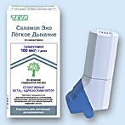
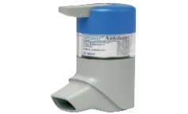
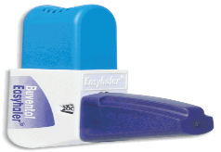
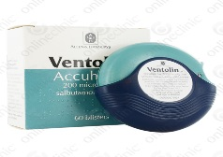
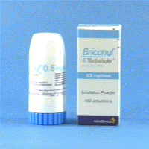
SABA (short acting beta agonist) inhalers
Aerosol Inhalers | Generic Component | No of doses | Cost/ device | Dosing directions
Ventolin© evohaler Salamol© inhaler | Salbutamol 100mcg/dose Salbutamol 100mcg/dose | 200 200 | £1.50 £1.46 | 1-2 puffs up to 4 times a day
Salamol© easibreathe | Salbutamol 100mcg/dose | 200 | £6.30 | 1-2 puffs up to 4 times a day
Airomir© autohaler | Salbutamol 100mcg/dose | 200 | £6.02 | 1-2 puffs up to 4 times a day
Dry Powder Inhalers | Generic Component | No of doses | Cost/ device | Dosing directions
Easyhaler© salbutamol | Salbutamol 100mcg/dose Salbutamol 200mcg/dose | 200 200 | £3.31 £6.63 | 1-2 puffs up to 4 times a day
Ventolin© Accuhaler | Salbutamol 200mcg/dose | 60 | £3.60 | 1 puff up to 4 times a day
Bricanyl ©turbohaler | Terbutaline 500mcg/dose | 100 | £8.30 | 1 puff up to 4 times a day

Slide 2
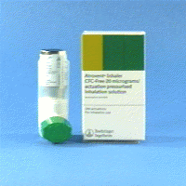
SAMA (short acting muscarinic antagonist <anticholinergic>) inhalers
Aerosol Inhaler | Generic Component | No of doses | Cost/device | Dosing directions | Licensed indications | Formulary Y/N
Atrovent© | Ipratropium 20mcg | 200 | £5.56 | 1-2 puffs three or four times daily | COPD Asthma | y

Slide 3
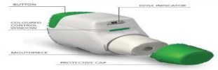

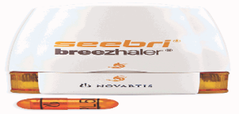
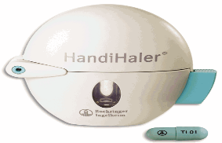

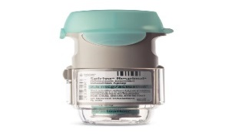
LAMA (long acting muscarinic antagonist <anticholinergic>) inhalers
Brand name/device name Dry Powder Inhalers | Generic Component | No of doses | Cost/ device | Dosing directions | Licensed indications
Eklira Genuair© | Aclidinium 322mcg | 60 | £28.60 | 1 puff twice daily | COPD
Incruse Ellipta© | Umeclidinium 55mcg | 30 | £27.50 | 1 puff daily | COPD
Seebri Breezhaler© | Glycopyrronium 50mcg | 30 | £27.50 | 1 cap daily | COPD
Spiriva Handihaler© | Tiotropium 18mcg caps (delivered dose of tiotropium is 10mcg) | 30 | £33.50 | 1 daily | COPD
Braltus Zonda© | Tiotropium 10mcg caps (delivered dose of tiotropium is 10mcg) | 30 | £25.80 | 1 daily | COPD
Aerosol Inhalers | Generic Component | No of doses | Cost/ device | Dosing directions | Licensed indications
Spiriva Respimat© | Tiotropium 2.5mcg | 60 | £23.00 | 2 puffs once daily | COPD over 18yrs Asthma –step 4 specialist initiation

Slide 4
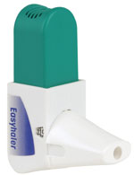
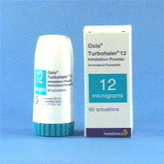
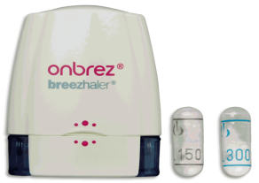
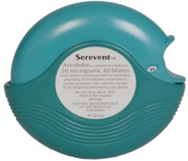
LABA (long acting beta agonist) inhalers – DPI (dry powder) devices
Brand/Inhaler type | Generic Component | No of doses | Cost/ device | Dosing directions | Licensed indication
Easyhaler© Formoterol Oxis turbohaler© | Formoterol 12mcg Formoterol 6mcg 12mcg | 120 60 | £23.75 £24.80 £24.80 | 1puff twice daily 1 or 2puffs daily | COPD Asthma From 6yrs
Onbrez Breezhaler© | Indacaterol 150mcg 300mcg | 30 | £32.19 £32.19 | 1 cap daily | COPD
Serevent© Accuhaler | Salmeterol 50mcg | 60 | £29.26 | 1 puff twice daily | COPD Asthma From 4yrs

Slide 5
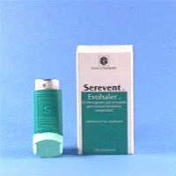
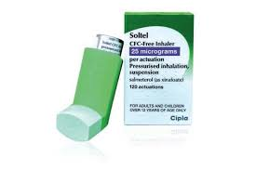
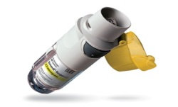
LABA (long acting beta agonist) inhalers –MDI aerosol devices
Brand/ Inhaler type | Generic Components | No of doses | Cost/ device | Dosing directions | Licensed indications
Serevent© evohaler | Salmeterol 25mcg/dose | 120 | £29.26 | 2 puff twice daily | COPD and Asthma from 4yrs
Soltel© inhaler | Salmeterol 25mcg/dose | 120 | £19.95 | 2 puffs twice daily | COPD and Asthma from 12yrs
Striverdi© Respimat | Olodaterol 2.5mcg/puff | 60 | £26.35 | 2 puffs once daily | COPD

Slide 6
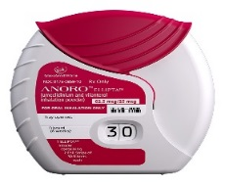
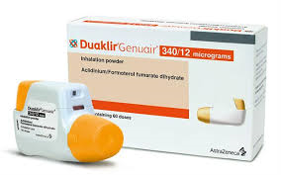
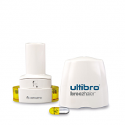
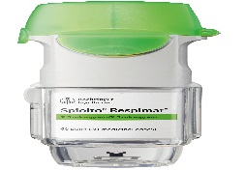
LABA/LAMA Combination Inhalers
(probably best used in mild to moderate disease where symptoms continue after using a LABA or LAMA alone)
Brand name | Inhaler Name /type | Generic Components | No of doses | Cost/ device | Dosing directions | Licensed indication
Anoro© | Ellipta©/DPI (DRY POWDER) | Vilanterol 22mcg/ Umeclidinium 55mcg | 30 | £32.50 | 1 puff daily | COPD
Duaklir© | Genuair©/DPI (DRY POWDER) | Formoterol 12mcg/ Aclidinium 340mcg | 60 | £32.50 | 1 puff twice daily | COPD
Ultibro© | Breezhaler©/DPI (DRY POWDER) | Indacaterol 110mcg/ Glycopyrronium 50mcg | 30 | £32.50 | 1 cap daily | COPD
Spiolto© | Respimat©/MDI (AEROSOL) | Olodaterol 2.5mcg/ Tioptropium 2.5mcg | 60 | £32.50 | 2 puffs once daily | COPD

Slide 7
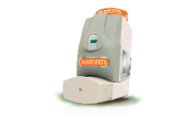

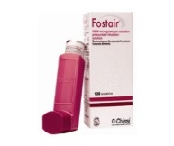
ICS/LABA Combination inhalers –Aerosol MDI devices ----Table 1
Probably best used in moderate to severe disease (in copd consider where FEV1 < 50% and 2 or more exacerbations in last 12 months or where combination of LABA and LAMA still does not control symptoms)
Aerosol inhaler | Generic components | No of doses | Cost/ device | Dosing directions | Licensed Indication | comments
Flutiform© ^{MDI} | Fluticasone/Formoterol 50mcg/5mcg 125mcg/5mcg 250mcg/10mcg | 120 | £14,40 £28.00 £45.56 | 2 puffs twice daily | Asthma – only | from age 12 years
Symbicort© ^{MDI} | Budesonide 200mcg/Formoterol 6mcg | 120 | £28 | 2 puffs twice daily | COPD - only | From age 18 years
Fostair© ^{MDI} | Beclometasone 100mcg/Formoterol 6mcg Also Beclometasone 200mcg/Formoterol 6mcg | 120 | £29.32 | 2 puffs twice daily 1-2 puffs twice daily | COPD and Asthma (200/6 Asthma only) | from age 18 years

Slide 8
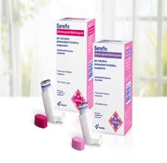
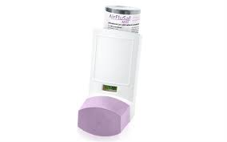
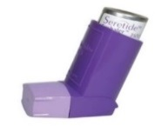
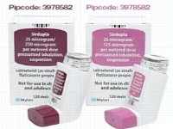
LABA/ICS Combination inhalers –Aerosol MDI devices------Table 2
Probably best used in moderate to severe disease (in copd consider where FEV1 < 50% and 2 or more exacerbations in last 12 months and combination of LABA and LAMA does not control symptoms)
Aerosol inhaler | Generic components | No of doses | Cost/ device | Dosing directions | Licensed Indication
Sereflo© ^{MDI} | Salmeterol/Fluticasone 25mcg/125mcg 25mcg/250mcg | 120 | £18.50 £29.95 | 2 puffs twice daily (Do not use spacer with 25/125 device) | Asthma – only from age 18 years
Airflusal © ^{MDI} | Salmeterol/Fluticasone 25mcg/125mcg 25mcg/250mcg | 120 | £18.50 £29.95 | 2 puffs twice daily | Asthma - only from age 18 years
Seretide© evohaler | Salmeterol/Fluticasone 25mcg/50mcg 25mcg/125mcg 25mcg/250mcg | 120 | £18 £35 £59.48 | 2 puffs twice daily | Asthma – only from age 4 years
Sirdupla© ^{MDI} | Salmeterol/Fluticasone 25mcg/125mcg 25mcg/250mcg | 120 | £26.25 £44.61 | 2 puffs twice daily | Asthma – only from age 18 years

Slide 9
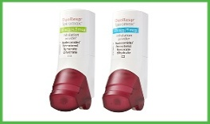
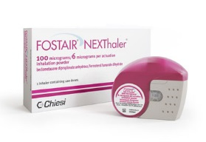
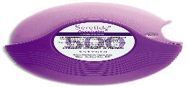
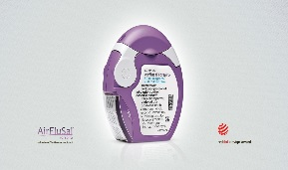
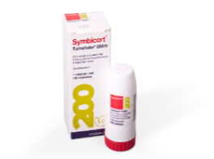
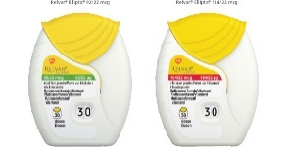
ICS/LABA Combination inhalers –Dry powder devices
Probably best used in moderate to severe disease (in copd consider where FEV1 < 50% and 2 or more exacerbations in last 12 months or where combination of LABA and LAMA still does not control symptoms)
Dry Powder Inhalers | Generic Components | No of doses | Cost/ device | Dosing directions | Licensed indications | Comments
Duoresp Spiromax© 160/4.5 320/9 | Budesonide/formoterol 200mcg/6mcg (160/4.5) 400mcg/12mcg (320/9) | 60 | £29.97 £29.97 | Varies depending on strength used and condition | COPD and Asthma from 18yrs | Branded generic of symbicort
Fostair Nexthaler© | Beclometasone 100mcg/ Formoterol 6mcg (also) 200mcg/6mcg | 120 | £29.32 | 1-2 puffs twice daily | COPD and Asthma 200mcg/6mcg asthma only | Note dose dependant on condition
Seretide© Accuhaler 100, 250, 500 | Fluticasone/Salmeterol 100mc/50mcgg 250mcg/50mcg 500mcg/50mcg | 60 | £18 £35 £40.92 | 1 puff twice daily | COPD – 500 only Asthma –all strengths From 4 yrs | Airflusal Forspiro© 50mcg/500 60 doses £29..97 Frm 18yrs (Branded generic of seretide accuhaler) COPD and asthma
Symbicort© Turbohaler 100,200,400 | Budesonide/Formoterol 100mcg/6mcg 200mcg/6mcg 400mcg/12mcg | 120 120 60 | £28 £28 £28 | Varies depending on strength used and condition | COPD -200 and 400 Asthma- all strengths From 6yrs
Relvar Ellipta© | Fluticasone/Vilanterol 94mcg/22mcg 184mcg/22mcg | 30 30 | £22.00 £29.50 | 1 puff daily | COPD (22mcg/94mcg) and Asthma (all strengths) from 12 yrs

Slide 10
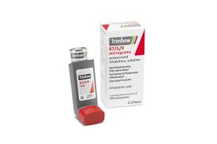
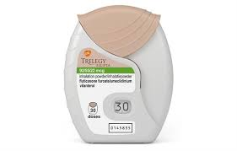
Triple Therapy (LABA/ICS/LAMA ) Combination inhalers
Aerosol MDI Inhaler | Generic Components | No of doses | Licensed indication | Cost | Dosing directions
Trimbow | Formoterol fumarate dihydrate 5 microgram, beclometasone dipropionate 87 microgram, glycopyrronium bromide 9 microgram per puff | 120 | COPD | £44.50 | 2 puffs twice daily
Dry Powder Inhalers | Generic Components | No of doses | Licensed indication | Cost | Dosing directions
Trelegy | Vilanterol trifenatate 22micrograms fluticasone furoate 92 microgram umeclidinium bromide 55microgram per puff | 30 | COPD | £44.50 | 1 puff daily

Slide 11
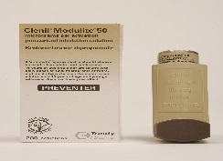
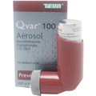
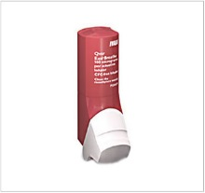
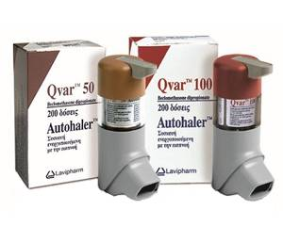
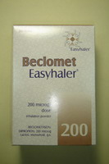
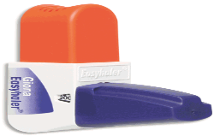
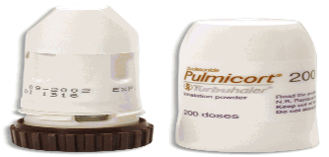
ICS (inhaled corticosteroid) inhalers –only licensed for use in asthma
MDI aerosol Inhalers (name of steroid) | Cost of Devices | No of doses | Dosing directions
Clenil Modulie© (beclometasone) from 2 years and above | Strength/ dose 50mcg £3.70 100mcg £7.42 200mcg £16.17 250mcg £16.29 | 200 | 1 or2 puffs up twice daily (specify dose)
Qvar© (extra fine particle beclometasone) From 12 years and above pMDI easibreathe autohaler | (note twice as potent as Clenil dose for dose) Strength pMDI easibreathe autohaler /dose 50mcg £7.87 £7.74 £7.87 100mcg £17.21 £16.95 £17.21 | 200 | 1 or2 puffs twice daily (specify dose)
Dry Powder Inhalers (name of steroid) | Cost of Devices | No of doses | Dosing directions
Easyhaler© (beclometasone) (budesonide) | Strength/dose Beclometasone Budesonide 200mcg 100mcg 200mcg 400mcg £14.93 £8.86 £17.21 £17.71 | 200 | 1 or2 puffs twice daily (specify dose)
Pulmicort Turbohaler© (budesonide) | Strength/dose 100mcg 200mcg 400mcg £14.25 £14.25 £14.25 | 200,100,50 | 1 or 2 puffs twice daily (Specify dose)

Slide 12
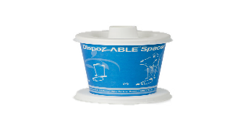
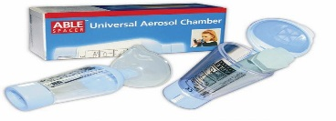
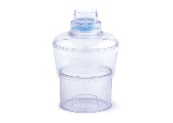
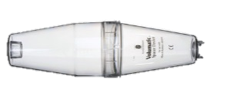
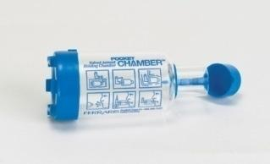
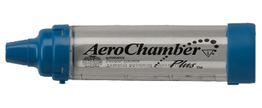
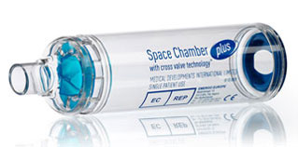
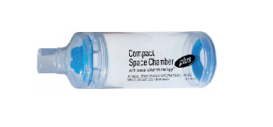
Examples of Spacers, their volume (size) cost of adult device without mask
(and with mask)
Volumatic (750ml) from £3.18 (£6.70) | DispoZable spacer approx £12.99 for 10 – Practices to consider using these for spirometry etc would have to purchase from practice suppliers | Able spacer (210ml) from £4.39 (£7.16) | A2A spacer (210ml) from £4.15 (£6.68)
Pocket Chamber (110ml) from £4.18 (£9.75) | Aerochamber plus (149ml) from £4.81 (£8.02) | Spacer Chamber plus (230ml) from £4.26 (£6.98) | Spacer Chamber Plus Compact (160ml). From £4.26 (£6.98)

