Slide 1



Gastroenterology Webinar
September 2020
7.00-8.30pm
Hosted by Greater Manchester Health and Social Care Partnership
Please turn off your videos and microphones for the duration of the webinar

Slide 2
Housekeeping
Please keep your microphones and videos switched off throughout the webinar.
Slides and a recording of the webinar will be available at GP excellence and GatewayC after the webinar has finished.
Please ask questions via the chat box.
Any questions which are not addressed during the webinar will be answered and published along with the slides/recording.

Slide 3
Itinerary
7.00pm - Introduction
  Dr Sophie Nelson, GP Kenmore Medical Centre, Wilmslow and GPwSI Gastroenterology, MFT
7.10pm - Abnormal LFT’s
  Dr Varinder Athwal, Hepatology Consultant, MFT
7.30pm - FIT testing – how and when to use.
  Dr Sarah Taylor, GP Bodey Medical Centre, Fallowfield and GP Cancer Early Diagnosis Lead for Greater Manchester
7.45pm – Upper and lower GI cancers
  Dr Alistair Makin, Gastroenterologist, MFT
8.15pm - Making the most of advice and guidance
  Dr May Aldean, GP The Maples and The Lakes Medical Centres and GPwSI in Hepatology and Gastroenterology, MFT

Slide 4
Introduction
Waiting times for Gastro appointments were already long pre-COVID19.
Endoscopy waiting times also long, now much longer.
Variability in access to A&G and tests (eg. FIT, FCP) across GM
Barriers to two-way discussions between primary and secondary care (eg. Gateway)

Slide 5
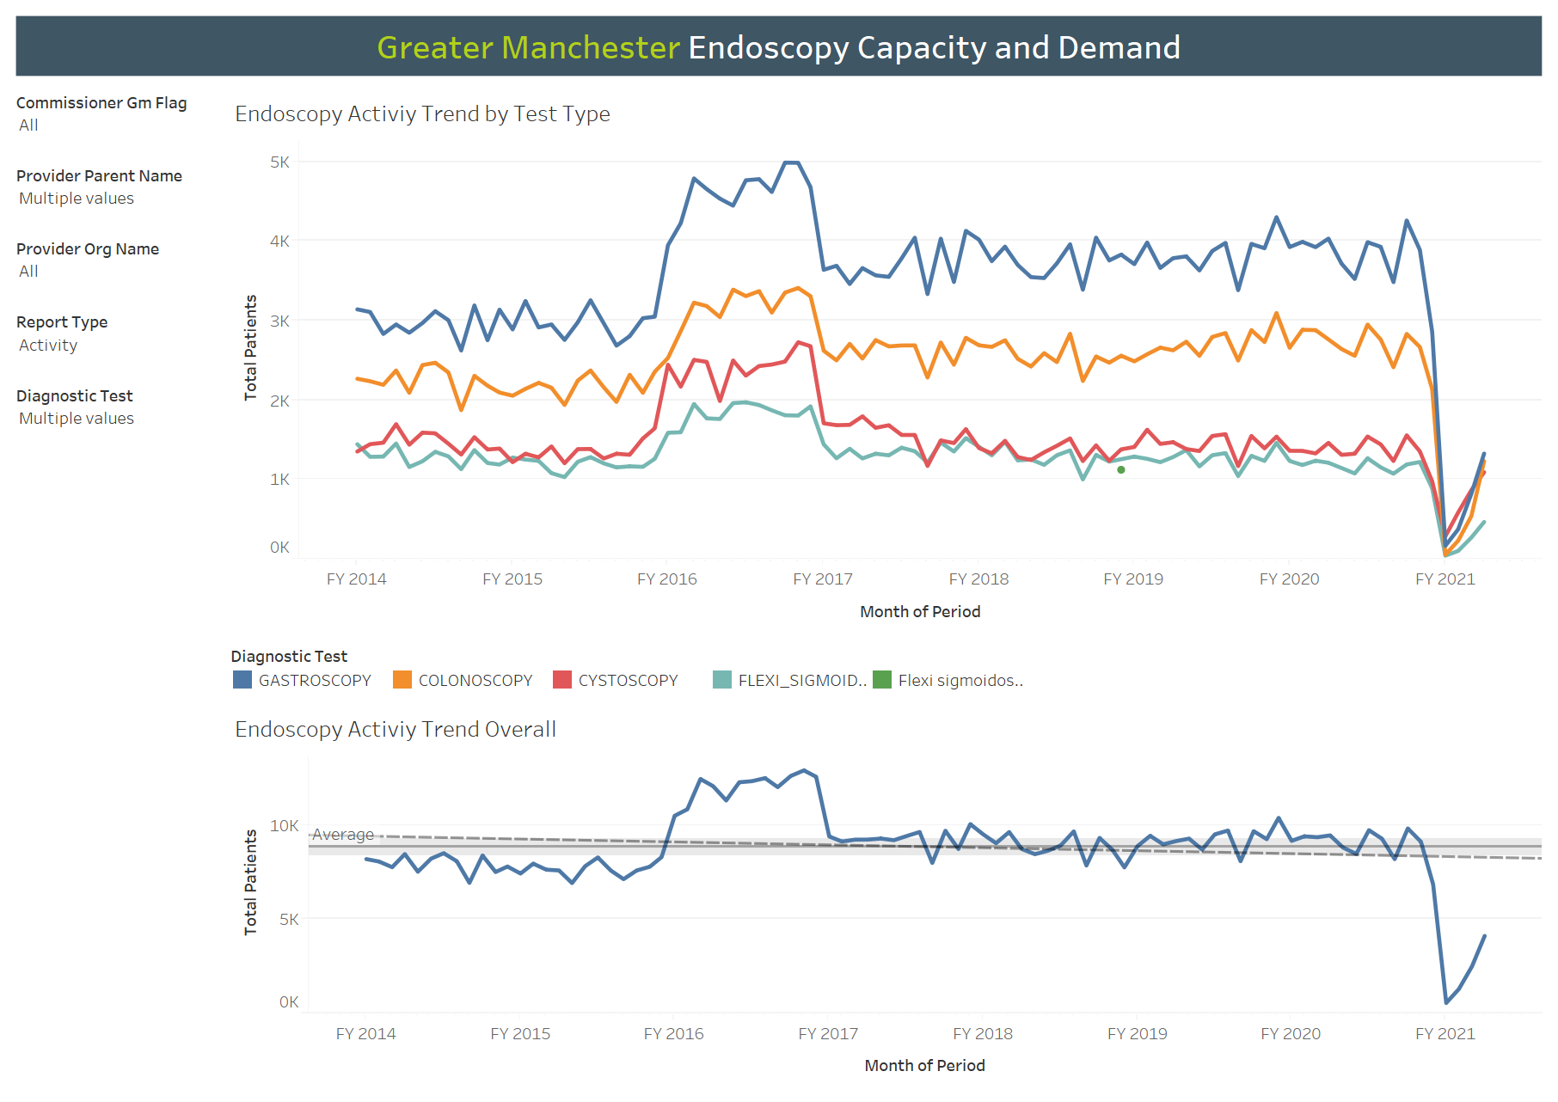

Slide 6
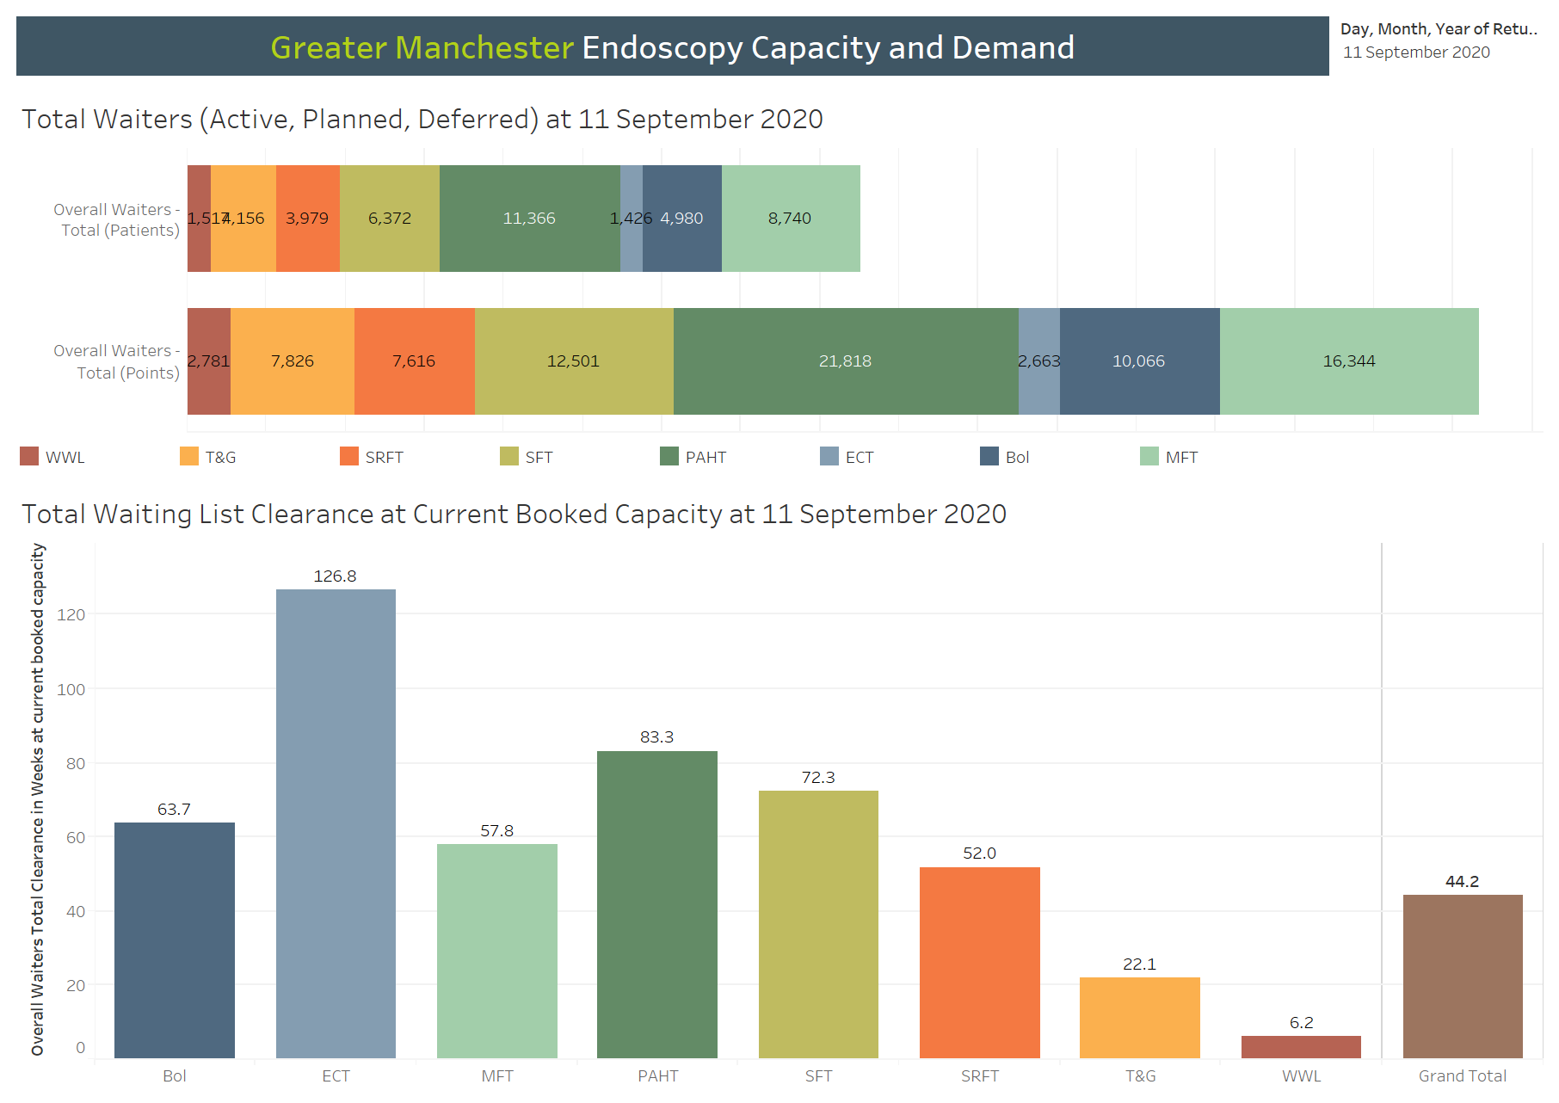

Slide 7
What does this mean for General Practice?
Patients are waiting longer – 2ww, urgent and routine
These patient are often symptomatic and contacting GP more as a result
Some patients are refusing procedures due to fear of COVID19
No direct access/community endoscopy

Slide 8
What is being done?
GM Trusts working together to maximise endoscopy across GM.
Patients being prioritised based on symptoms and test results
A&G rolled out in all areas
Greater access to tests for Primary Care (eg. FIT, FCP)
Bowel cancer programme has restarted
Patient communication campaign via social media to encourage patients to attend appointments (https://www.youtube.com/watch?v=T1JTe7Sq66U&feature=youtu.be)

Slide 9
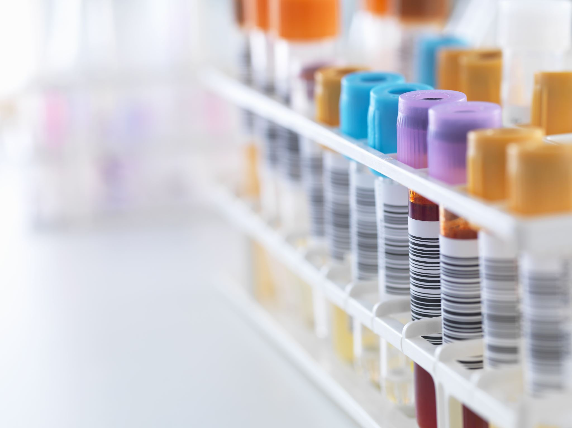
Improving the detection and management of liver disease in primary care
Varinder Athwal
Consultant Hepatologist, MFT

Slide 10
What We will talk about
Why is diagnosing liver disease important?
Why is it a primary care issue?
What can be done to improve early detection?

Slide 12
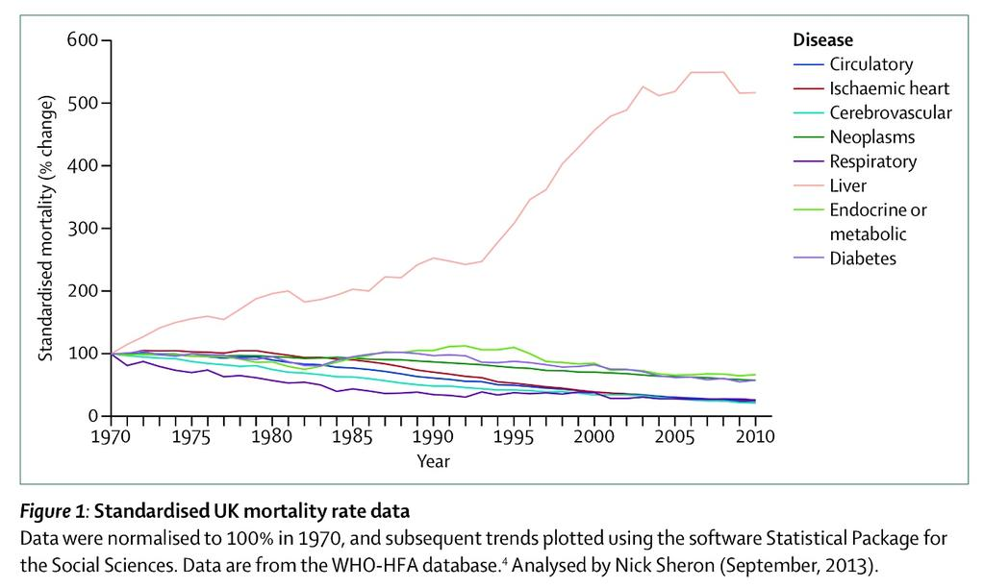
Liver Disease
The only major cause of death still increasing year-on-year.
Since 1970 risen 4-fold in people under 65.

Slide 13
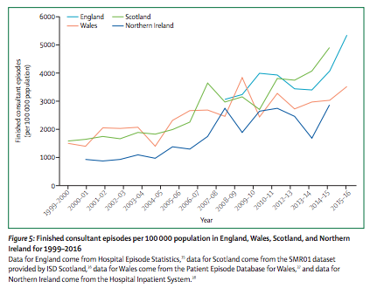
Across the four nations, referrals for NAFLD rising

Slide 14
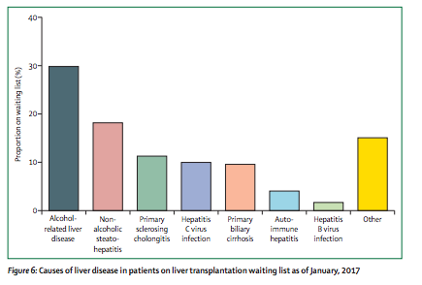
NAFLD is becoming a leading cause for liver transplant

Slide 15
Why is it a primary care issue?
“Strengthen detection of early liver disease and its treatment by improving the level of expertise and facilities in primary care …. putting this recommendation first represents its importance we have accorded it “
Lancet commission 2014

Slide 16
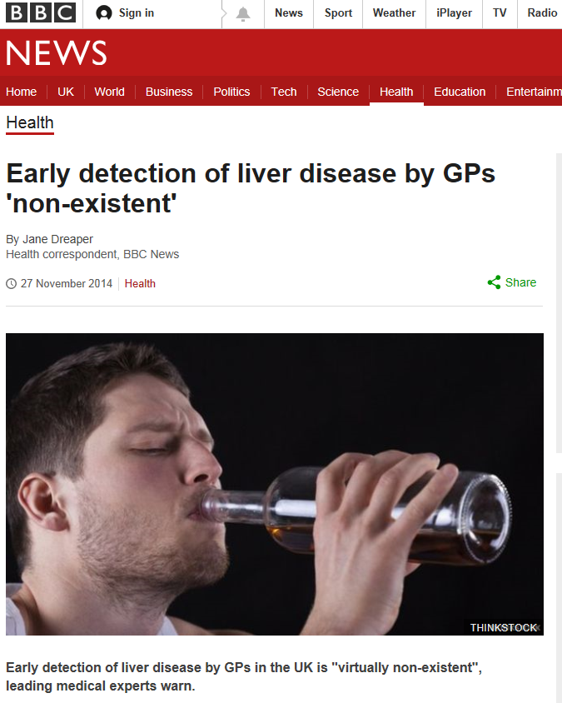

Slide 17
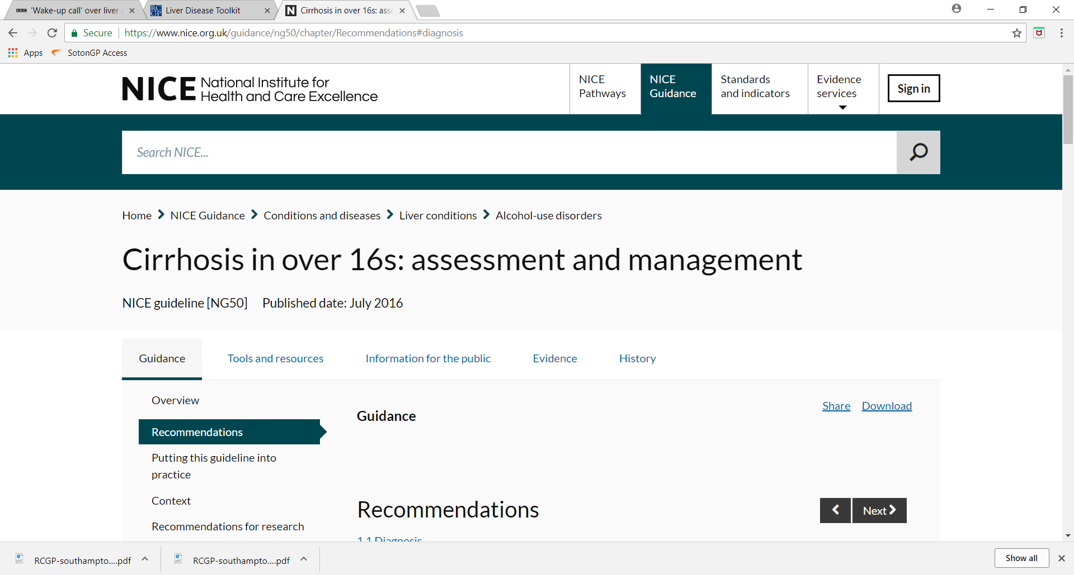
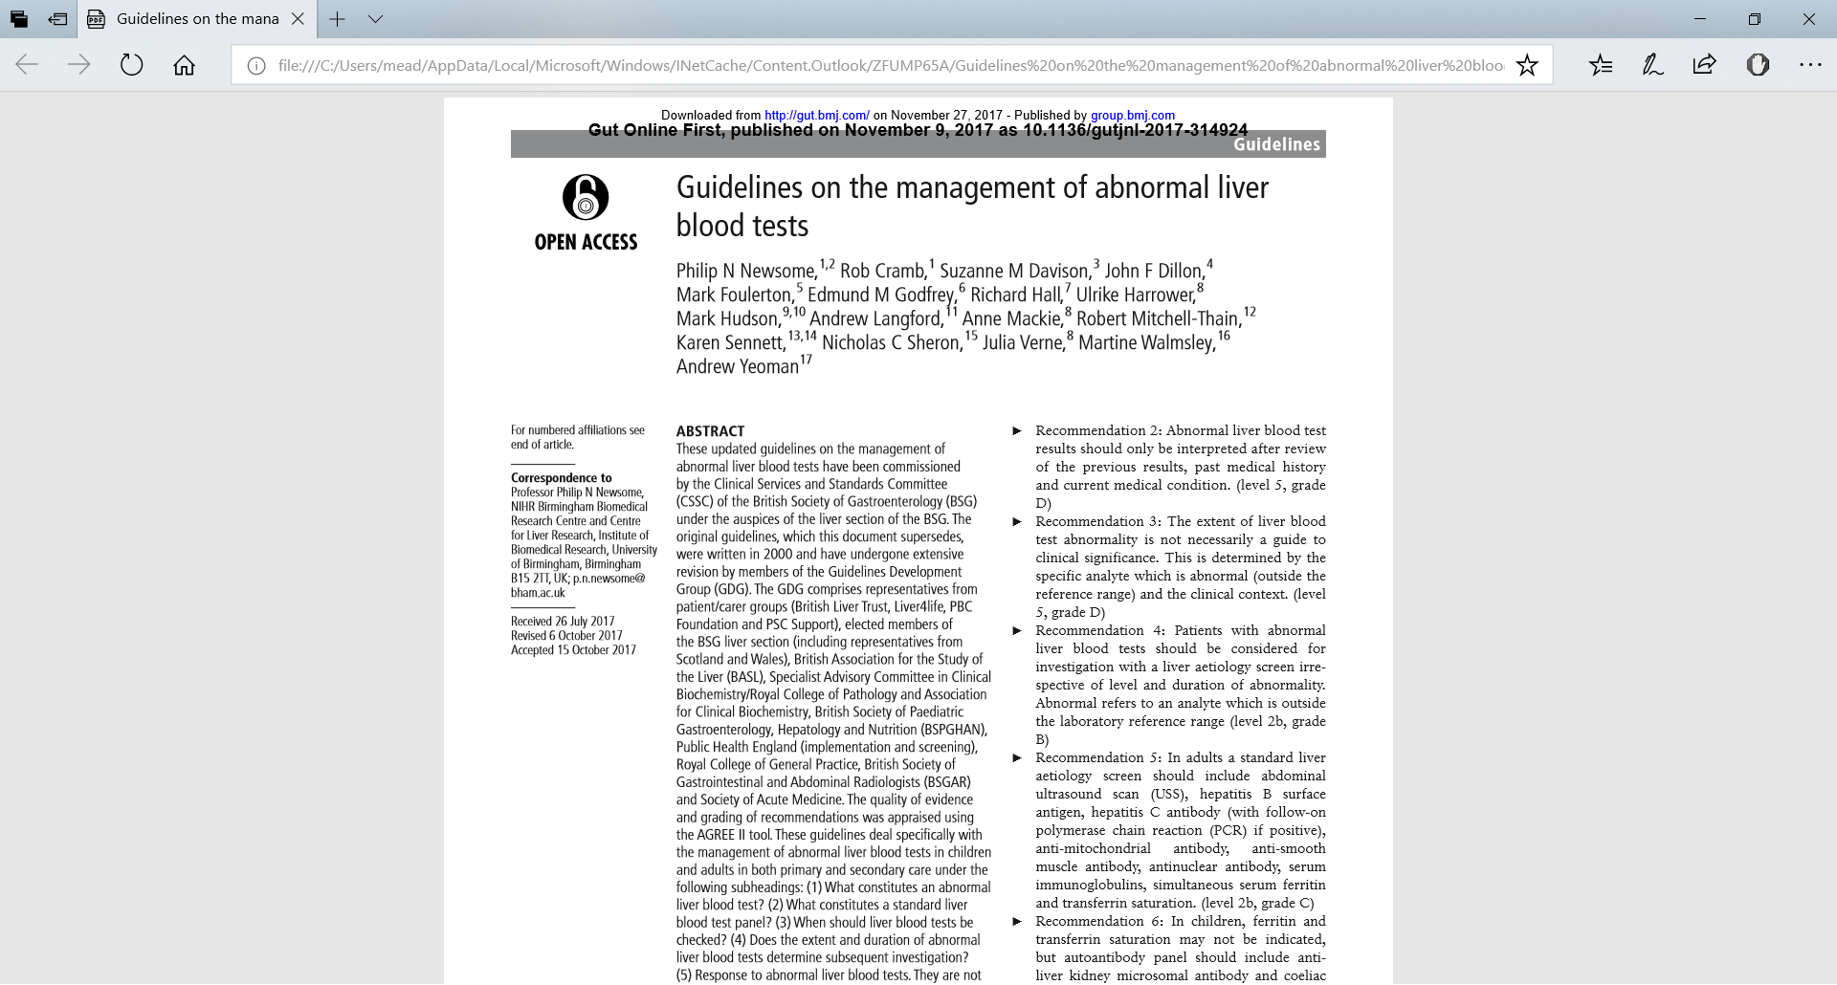
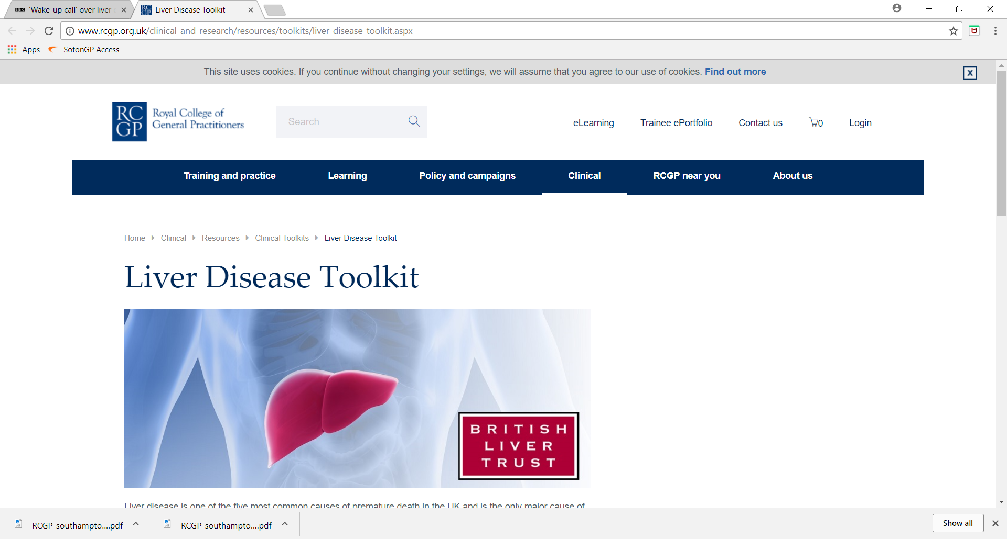

Slide 18
The challenges for primary care:
Making liver disease part of routine chronic disease management.
Feeling confident in interpretation of abnormal liver blood tests.
Finding and engaging our high-risk patients.
Time and resources for brief interventions.
Access to support services.
Being up to date with latest local and national guidance.
Improving communication with secondary care.

Slide 19
Non Alcoholic Fatty Liver Disease (NAFLD)
NAFLD is now the commonest cause of abnormal LFTs in the UK due to increasing rates of obesity
Up to 90% of patients with NAFLD have ‘simple’ steatosis which has a benign prognosis
10 – 30% have non-alcoholic steatohepatitis (NASH)
  Associated with hepatic inflammation and injury
  25 – 40% of patients with NASH will develop progressive liver fibrosis and ultimately cirrhosis in 20 – 30%
Independent predictor of cardiovascular mortality.
Pisto et al. BMJ Open. 2014

Slide 20
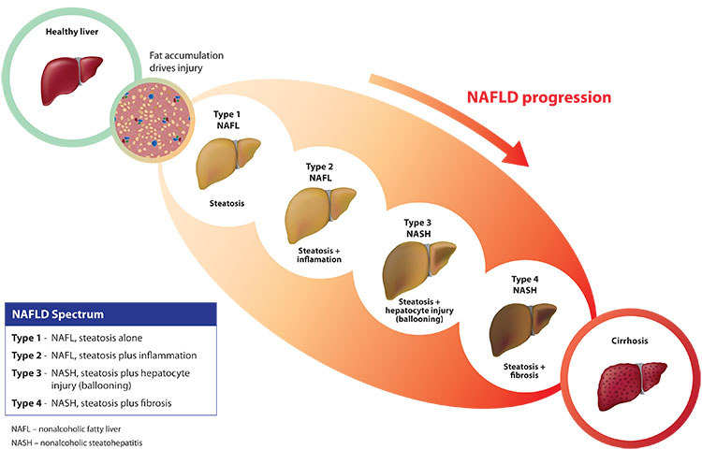
NAFLD
15-30%
3-5%
NASH
http://www.tobiratx.com/patient-resources/nash/

Slide 21
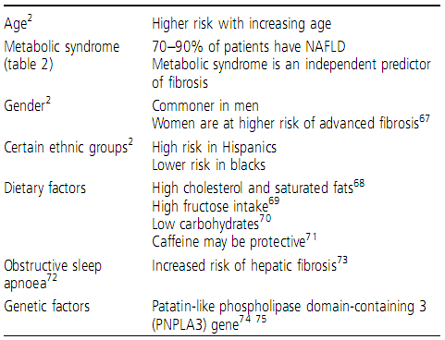
Risk factors for NAFLD
Dyson et al. Frontline Gastroenterology 2014

Slide 23
Tips and Tricks
Suspect NAFLD if
  Any evidence of metabolic risk factors and T2DM
  ALT raised +/- rises in GGT/ALP
  Alcohol has similar profile but AST>ALT (usually).
  Raised ferritin often in association
Don’t stop statins (unless ALT doubles upon starting)

Slide 24
Tips and Tricks (cont...)
Suspect cirrhosis/significant fibrosis with NAFLD if above +
  Low platelets
  Stigmata of chronic liver disease (spider naevi, palmer errythema, etc)
  Rise in Bil/INR or decrease in albumin
  Older patients (males>females)
Always do a FIB-4 – still get the odd surprises
If not sure/concerned – please refer or use A&G service.

Slide 25
Thank you

Slide 26
Advice & Guidance
What?
Why?
When?

Slide 27
What is A&G?
A&G is defined as non F2F activity delivered by consultant-led services to provide Primary Care with access to specialist clinical advice
A digital communication channel (via Gateway) allows a GP to seek advice from a specialist instead of a referral.
Transform the way referrals are managed and complements local referral pathways
Central to supporting the mmt of pts in primary care, as well as restoration & recovery of elective services

Slide 28
Why use A&G?
Improved interface between 1º & 2º care
GP
Continue to manage pt in community with consultant advice
Minimise risk of redirection/rejection referral
Guidance on most appropriate pathway/service to use
Help achieve Standard 9 of Manchester Primary Care Standards (Mcr GPs only)
Improve quality of referral if needs conversion to OPD
Education resource – will help in future mmt of similar pts
Patient
Access to consultant advice within days
Management remains in community
Pt can be directed to most appropriate clinic
Pt has necessary Ix & Rx at most appropriate point in referral pathway
Reduced waiting time for OPD appts
Specialist Clinician
Only pts that need specialist service are seen/cost effective use of time
Ensure all diagnostic tests complete before OPD
Pts channelled to most appropriate clinic
Advice re appropriate tests/pathways to standardise care
Ease pressure on OPD and diagnostic slots

Slide 29
When to use A&G?
Advice on investigations , treatment options and management plans
If unsure if pt meets 2ww criteria
Known IBS with current flare of sx
New IBS with low calprotectin and struggling to control sx ( Calprotectin Pathway)
Dyspepsia and reflux symptoms in new presentations and in pts who have previously had OGDs
( Dyspepsia Pathway)
Recurrence of previously Ix IDA ( IDA pathway )
Patients who have previously been Ix under a 2ww pathway and have ongoing sx
Abnormal LFT <2x ULN and negative liver screen and normal USS liver (Abn LFT & Fatty liver pathway )
Hepatic cysts, haemangiomas and ?gallbladder polyps on USS liver
Raised ferritin with normal Fe studies
Isolated raised GGT or ALP
Mildly raised AMA and SMA levels with normal LFTs
Concerns re family history of GI caner
Queries regarding polyp or Barrett's surveillance
When not to use A&G
Suspected cancer or patient needs admission
Do not mark referrals as urgent – will be returned by Gateway
Should not be used to chase non-clinical queries

Slide 30
MFT A&G – April 20 – Aug 20
          88 A&G referrals ( av 5.5 ref /week)
          8 needed converting to OPD
          90% did not need secondary care review or Ix
          Agreed response time is 2 working days
Other stats available online:
Somerset 2017 – 54% all gastro referrals avoided conversion to OPD
Stockport 2017 – 48% all gastro referrals avoided conversion to OPD

Slide 31
Take Home Message
Consider A&G as first line at the point of a non 2WW referral

Slide 32



Faecal-immunochemical testing (FIT)
© Copyright Greater Manchester Cancer. All rights reserved.
© Copyright Greater Manchester Cancer and GatewayC. All rights reserved.

Slide 33


FIT in screening
In England people between the ages of 60 and 74 are invited once every 2 years to take part in bowel cancer screening
In June 2019 screening test changed from FOB to FIT
Sensitivity threshold is 120ug/g in England (150ug/g in Wales and 80ug/g in Scotland
FIT is specific to human haemoglobin, which is a significant advantage over gFOBt resulting in fewer false positives
FIT needs only one sample of stool, compared with six required for gFOBT (two samples from three separate stools) resulting in increased uptake
@GM_Cancer
@GatewayC_ I Faecal-immunochemical testing (FIT)

Slide 34
Symptomatic FIT
NICE DG30 recommends the use of FIT in patients without rectal bleeding, who have unexplained symptoms, but do not meet the criteria for a suspected cancer referral pathway
Results should be reported using a threshold of 10 micrograms of haemoglobin per gram of faeces (as opposed to 120microgram threshold used in screening)
@GM_Cancer
@GatewayC_ I Faecal-immunochemical testing (FIT)

Slide 35
Suspected cancer referral guidelines
Refer adults using a suspected cancer pathway referral (for an appointment within 2 weeks) for colorectal cancer if:
they are aged 40 and over with unexplained weight loss and abdominal pain
they are aged 60 and over with:
iron‑deficiency anaemia
changes in their bowel habit
are aged 60 or over and have anaemia without iron deficiency
@GM_Cancer
@GatewayC_ I Faecal-immunochemical testing (FIT)

Slide 36
Endoscopy prioritisation
In the initial stages of the COVID-19 pandemic endoscopy services were suspended except for emergency procedures. Whilst they are starting to increase, for logistical reasons they are not back to normal and there is still a significant back log.
To support prioritisation GPs are asked to request a FIT test in these patients. They do not need to wait for or deal with the result and should not base their referral decision on it.
If a FIT test is not requested or received the referral will not be rejected. If the patient is deemed low risk by FIT they will be kept on a waiting list and either have a face to face assessment or a colonoscopy at a later date.
@GM_Cancer
@GatewayC_ I Faecal-immunochemical testing (FIT)

Slide 37
Reason for prioritisation
25% of patients referred with symptoms of lower GI cancer and FIT>100 will have colorectal cancer
<1% of patients referred with symptoms of lower GI cancer and FIT < 10 will have colorectal cancer (NB FIT < 10 does not exclude other cancers)
@GM_Cancer
@GatewayC_ I Faecal-immunochemical testing (FIT)

Slide 38
Points to consider
Use in “vague” symptoms pathway
Younger patients- every year over 2,500 younger people are diagnosed with bowel cancer in the UK. This is only around six per cent of those diagnosed, but is slowly increasing
Reaching 75% stage 1 and 2 diagnosis by 2028
@GM_Cancer
@GatewayC_ I Faecal-immunochemical testing (FIT)

Slide 39
Practicalities
FIT is now available across Greater Manchester
Requests are made in the usual manner
GPs will be responsible for safety netting requests
@GM_Cancer
@GatewayC_ I Faecal-immunochemical testing (FIT)

Slide 40
Additional resources
GatewayC, a free online cancer education platform for primary care professionals across England https://www.gatewayc.org.uk/
Bowel symptom diary https://www.bowelcanceruk.org.uk/news-and-blogs/news/download-our-brand-new-symptoms-diary/
CRUK- Key things to know about FIT -https://www.cancerresearchuk.org/sites/default/files/fit_implementation_england.pdf
@GM_Cancer
@GatewayC_ I Faecal-immunochemical testing (FIT)

Slide 41

Q&A
© Copyright Greater Manchester Cancer and GatewayC. All rights reserved.

Slide 42
GM Guidelines for Upper and Lower GI Cancer
Alistair Makin
Consultant Gastroenterologist
Manchester royal Infirmary

Slide 43
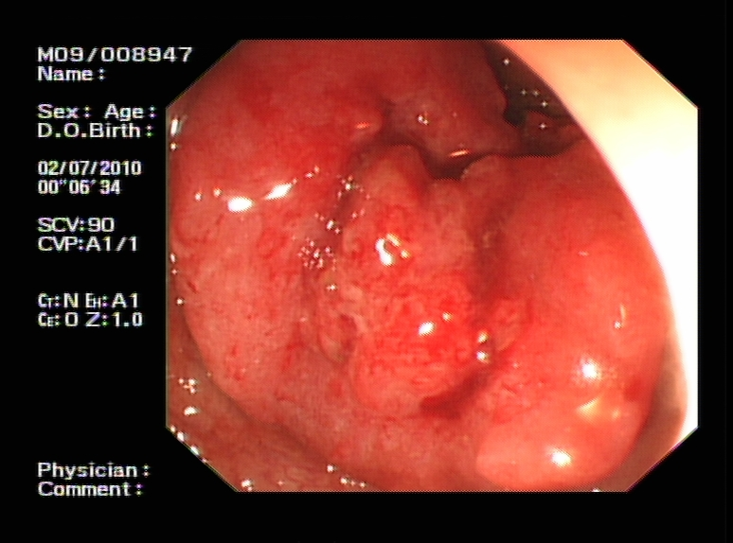
Colon Cancer

Slide 44
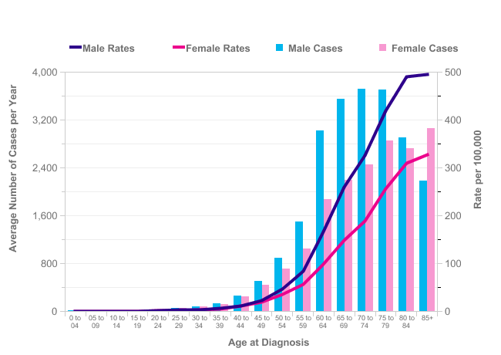
Average Number of New Cases Per Year and Age-Specific Incidence Rates per 100,000 Population, UK

Slide 45
Colon Cancer
Incidence
  45-55 25/100,000
  >75 300/100,100
80% of cases aged over 60
North West 2nd highest incidence in England
Incidence increasing with ageing population
Sporadic 95%
Genetic 5%
  HNPCC 3 family members with CRC 2 generations affected
  1 family member <50
  FAP Multiple polyps
  100% risk of cancer by 40

Slide 46
Symptoms of CRC
20% Emergency presentation BUT usually symptoms for weeks
  Obstruction
  Perforation
80% present with symptoms
  Altered bowel habit to a looser stool
  Rectal bleeding
  Abdominal pain often severe
  Abdominal mass
  Iron Def Anaemia
  Weight loss

Slide 47
Positive Predictive values of ≥ 5% in primary care cancer
A Systematic Review
25 studies with PPV’s of 5% or more
Rectal bleeding or new onset rectal bleeding
None aged <60
Equivocal aged 60-74
Iron Deficiency Anaemia
Moderate evidence
men aged > 20 with Hb≤ 12g/dl
women aged >50 with Hb < 11g/dl
Shapley et al Br J Gen Pract 2010

Slide 48
Diagnostic value of Symptoms
A systematic review of symptomatic adults in primary care to 2010
23 papers studied – CRC rate ranged from 0.4 – 23.2%
Rectal bleeding PPV 8.1
No difference between new onset or established
Increased risk with
Weight loss AND CIBH
Iron deficiency anaemia
Lower risk with
Decreased appetite
Diarrhoea
Constipation
Perianal symptoms
Astin et al Br J Gen Pract 2011

Slide 49
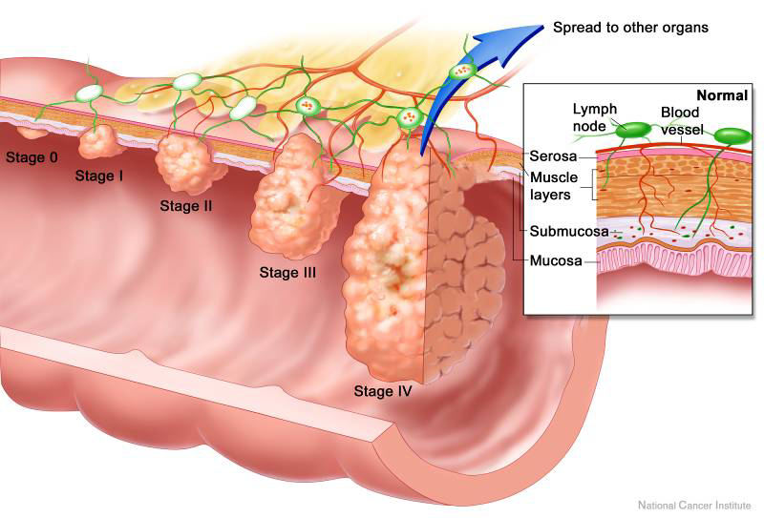
Cancer Staging – Predicting Outcome
Dukes A
Dukes B
Dukes C
Dukes D

Slide 50
Dukes Stage at Presentation
Symptomatic Patients v BCSP
Dukes Stage | Symptomatic (%) | BCSP (%) | 5 year Survival (%)
A | 11 | 39 | 85
B | 35 | 29 | 64
C | 26 | 25 | 38
D | 29 | 7 | 5

Slide 51
NICE Guidelines – NG12 – Colorectal Cancer(updated 11/09/20)
2 Week Referral
Non 2 Week Referral – Consider FIT Test
Abdominal or Rectal or Anal mass
Abdominal Pain
No weight loss
No rectal bleeding
Abdominal Pain
> 40 with weight loss
> 50 with rectal bleeding
Change in Bowel Habit
< 60 without rectal bleeding
Change in Bowel Habit
< 50 with rectal bleeding
> 60
Rectal Bleeding
> 50
< 50 with any of
abdominal pain
change in bowel habit
weight loss
Iron Deficiency anaemia

Slide 52




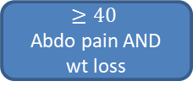

Lower GI Suspected Cancer – Recognition & Referral
Any age Anal/rectal/abdo mass
$$≥40$$
Abdo pain AND wt loss
≤50
Rectal bleeding AND 1 or more
≥ 50
Rectal bleeding
$$≥60$$
And 1 or more
Fe def anaemia
Wt loss
CBH˟
Abdo pain
CBH˟
Fe def anaemia
FIT
2WW Lower GI Referral
Consider GI
referral or advise & guidance
if concerns/persistent symptoms
Consider repeat FIT in 3m & if remains <10 bowel ca can be excluded
FIT testing has a very high
negative predictive value for
colorectal cancer
Triage with FIT – Timing
>100ug/gm – 2WW investigation
>10 <100ug/gm – Urgent investigation
< 10ug/gm – Safety netted W/L
≥ 10
˂ 10
FIT
˟CBH – Change in bowel habit – please specify how bowels have changed.
To constipation – Ix by CTVC/CT abdo
To diarrhoea – Ix by colonoscopy
≥50
Abdo pain OR wt loss
≤ 60
CBH˟ OR fe def anameia
≥ 60
non fe def anaemia

Slide 53

Lower GI Suspected Cancer – Recognition & Referral
Any age Anal/rectal/abdo mass
Abdo pain AND wt loss
≤50
Rectal bleeding AND one or more of
≥ 50
Rectal bleeding
And 1 or more
Fe def anaemia
Wt loss
CBH˟
Abdo pain
CBH˟
Fe def anaemia
Patients referred as 2ww with a FIT of <10 and no iron -def anaemia, rectal bleed or palpable mass, will get a face to face review and can be stepped down from the cancer pathway if appropriate
2WW LOWER GI REFERRAL
Please see referral template for guidance on useful investigations to request at time of referral to enable secondary care triage
≥ 10
Consider GI
referral or advice & guidance
if concerns/persistent symptoms
Consider repeat FIT in 3m & if remains <10 bowel ca can be excluded
FIT testing has a very high
negative predictive value for
colorectal cancer
˂ 10
FIT
˟CBH – Change in bowel habit – please specify how bowels have changed.
To constipation – Ix by CTVC/CT abdo
To diarrhoea – Ix by colonoscopy
≥50
Abdo pain OR wt loss
≤ 60
CBH˟ OR fe def anameia
≥ 60
non fe def anaemia

Slide 54
Suspected Cancer Referral for Lower GI
Referral Reason
As the tick boxes have now been removed the referral reason is mandatory
Referring to the NG12 referral guidance below, please explain why you are referring this patient for examination on a suspected cancer pathway. Please include any relevant examination findings including abdominal and PR examination, BMI, family history, quantify weight loss and previous history of cancer.
https://www.nice.org.uk/guidance/ng12
Refer urgently and complete FIT test for patients:
*Please do not wait for or deal with the result of the FIT test before submitting the referral*

Slide 55
Iron Deficiency Anaemia
Present in 11 – 57% of cancers
up to 80% of right sided colonic tumours
UK retrospective study of 2600 IDA patients referred to secondary care
38 colonoscopies to detect 1 curable CRC
527 gastroscopies to detect curable UGI cancer
Potentially curable malignancy diagnosed 13 x more frequently with lower GI investigation v OGD
Stephens et al QJM 2006

Slide 56
Asymptomatic Iron Deficiency Anaemia and Iron Deficiency without Anaemia (ferritin <13 (female) or <30 (male)
Male or post-menopausal female
Premenopausal
Female:
FIT >10
or
>50y
or
strong FH of CRC
FBC
Ferritin
B12 and folate
TTG
Haemoglobinopathy screen (if indicated)
Urine dip
FIT
Faecal calprotectin
FIT
TTG
FIT <10
and
<50y
and
no FH CRC
Iron supplementation (3 months ferrous sulphate 200mg TDS or equivalent)
Recheck Hb and ferritin 3 monthly for 12 months
Anaemia persists
or recurs
Refer 2ww Gastro
Anaemia resolves
No further action required

Slide 57
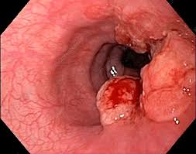
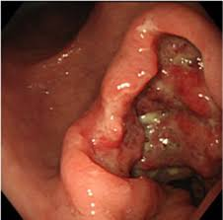
Upper GI Cancer

Slide 58
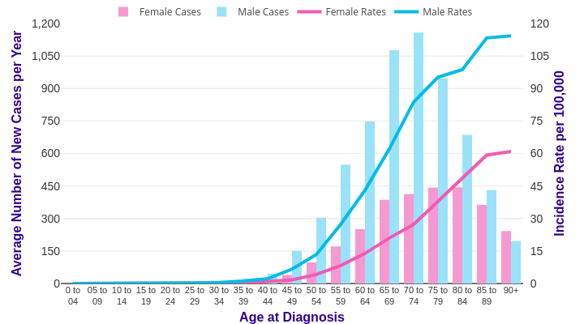
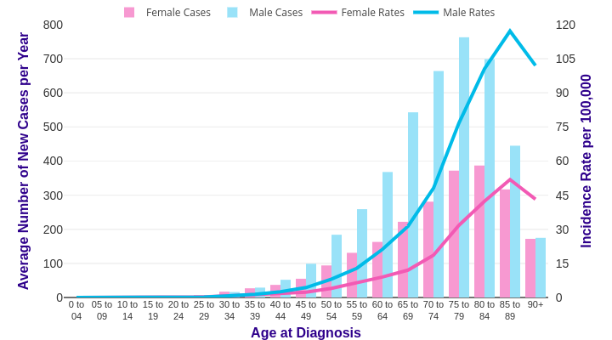
Average Number of New Cases Per Year and Age-Specific Incidence Rates per 100,000 Population, UK
Oesophagus
Gastric

Slide 59
Upper GI Cancer - Incidence and Survival
Oesophagus
Stomach
Highest incidence in older people
41% cases > 75
Male > Female
Survival highest 50-59 year olds
Survival linked to deprivation
50-60% higher mortality
12% 10 year survival
Highest incidence in older people
51% cases > 75
Male > Female
5 year survival decreases with age
15-39 35%
80-99 8%
17% 10 year survival

Slide 60
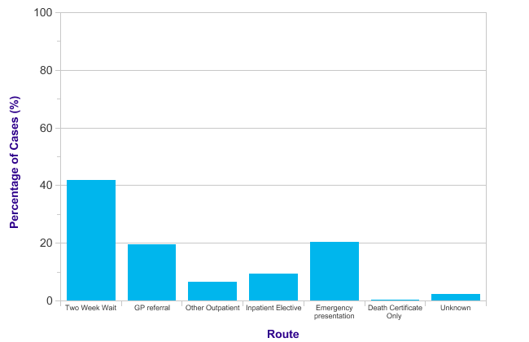
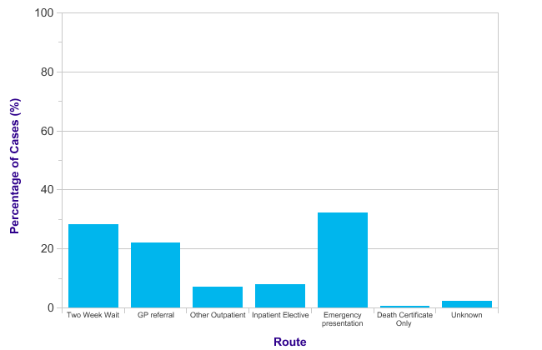
Upper GI Cancer – Route to Diagnosis
Oesophagus
Stomach

Slide 61
Upper GI Cancer – Symptoms
Oesophagus
Stomach
Dysphagia – progressive
Dyspepsia/reflux – persistent
Odynophagia
Weight loss
Weight loss
Abdominal pain/discomfort
Dyspepsia/reflux – persistent
Anorexia
Premature satiety
Haematemesis/melaena

Slide 62
NICE Guidelines – NG12 – Upper GI Cancer(updated 11/09/20)
2 Week Referral
Non 2 Week Referral
Dysphagia
Haematemesis
Age ≥ 55 with
Treatment-resistant Dyspepsia OR
Upper abdominal pain with low Haemoglobin OR
Raised platelet count with any of
Nausea/vomiting
Weight loss
Reflux/dyspepsia
Upper abdominal pain
Nausea or vomiting with any of
  Weight loss
Reflux/dyspepsia
Upper abdominal pain
Weight Loss
≥ 50 with any of
upper abdominal pain
reflux
dyspepsia
Upper abdominal mass

Slide 63
Edinburgh Dysphagia Score (EDS)
574 consecutive referrals
Aim – develop scoring system to categorise patients to high or low risk of malignancy
Score ≥ 3.5 – 20% cancer
- 1 missed case
Score < 3.5 - 35% of referrals
- not need 2WW OGD
PPV – 98% NPV 99.3%
Score calculated using
Age
Gender
Current Acid Reflux
Dysphagia localised to neck
Weight loss >3kg
Symptoms >6 months
Rhatigan et al Br J Surg 2010
BSG recommend EDS for Triage

Slide 64
Edinburgh Dysphagia Score (EDS) - Calculation
A Age | Points
18-36 | 0
40-49 | 4
50-59 | 5
60-69 | 6
70-79 | 7
80-89 | 8
90-99 | 9
B Gender
Male | 0
Female | -1
C Current Acid Reflux
Yes | -1
No | 0
D Dysphagia localises to Neck
Yes | -2
No | 0
E Weight loss >3 Kg
Yes | 2
No | 0
F Duration of Symptoms > 6m
Yes | -1.5
No | 0
EDS = A+B+C+D+E+F
If score ≥ 3.5 patient requires urgent investigation as higher risk of cancer
If score < 3.5 patient can have routine endoscopy
Rhatigan et al 2010 – 574 patients
30-35% 2WW referrals EDS < 3.5
20% cancer rate with EDS >3.5
1 missed cancer with EDS <3.5 NPV – 99.3%
Murray et al 2012 – 2000 patients
3 patients with EDS of 3 had cancer NPV – 98%

Slide 65
Predictive Value of Symptoms - Dysphagia
Prospective study of 2000 referrals
Reflux 41%
Malignancy 11%
Dysmotility 10%
Benign stricture 10%
Normal 12%
EDS – PPV – 98.4% NPV – 98%
BUT 3 missed cancers
Factors associated with Malignancy |  | OR
Age > 60 | (↑ >73)
Male | 3.3 x ♀ | 3.3
Symptoms < 8weeks |  | 9.6
Symptoms 8-26 weeks |  | 6
Progressive Symptoms |  | 1.8
Weight loss >2kg |  | 3.6
Reflux |  | 0.54
Symptoms > 26 weeks |  | 1
-
Murray et al World J Gastroenterol 2012

Slide 66
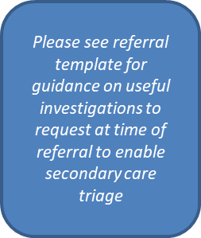
Upper GI Suspected Cancer – Recognition & Referral
Age ≥55 with weight loss
AND 1 or more
Dysphagia
Upper abdo pain
Reflux
Dyspepsia
2WW OGD

Slide 67
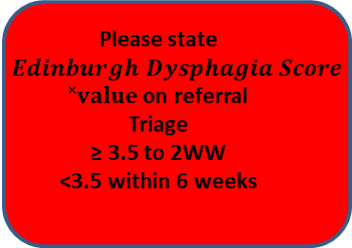
Upper GI Suspected Cancer – Recognition & Referral
Age ≥55 with weight loss
AND 1 or more
Dysphagia
Upper abdo pain
Reflux
Dyspepsia
Please state $Edinburgh Dysphagia Score$
$˟value$ on referral
Triage
≥ 3.5 to 2WW
<3.5 within 6 weeks
2WW OGD
˟EDS- Edinburgh Dysphagia Score

Slide 68

Upper GI Suspected Cancer – Recognition & Referral
Age ≥55 with 1 or more
Upper abdo pain AND anaemia
Raised platelets AND ≥ 1 of
Nausea /Vomiting
AND ≥ 1 of
Treatment resistant dyspepsia
Nausea/ vomiting
Weight Loss
Reflux
Dyspepsia
Upper abdo pain
Weight loss
Reflux
Dyspepsia
Upper abdo pain
Non 2WW OGD
Haematemesis

Slide 69
Suspected Cancer Referral for Upper GI
Referral Reason Referring to the NG12 referral guidance below, please explain why you are referring this patient for examination on a suspected cancer pathway. Please include any relevant examination findings including BMI, family history, quantify weight loss and previous history of cancer. https://www.nice.org.uk/guidance/ng12

Slide 70
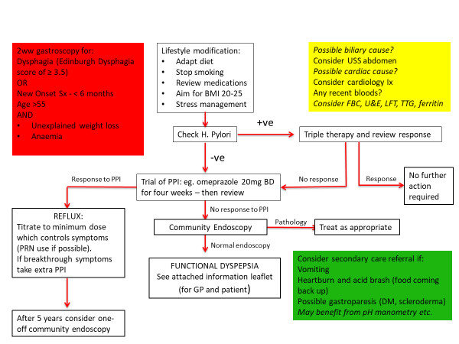
Dyspepsia

Slide 71
Conclusion
Joint guidelines for both primary and secondary care
Aim to put highest risk through 2WW pathway
Non 2WW referrals will be stratified by secondary care
Not to be used to block or bounce referrals
‘Grey Area’ patients to be discussed via helpline
Patients developing new symptoms on W/L can be upgraded

