Slide 1

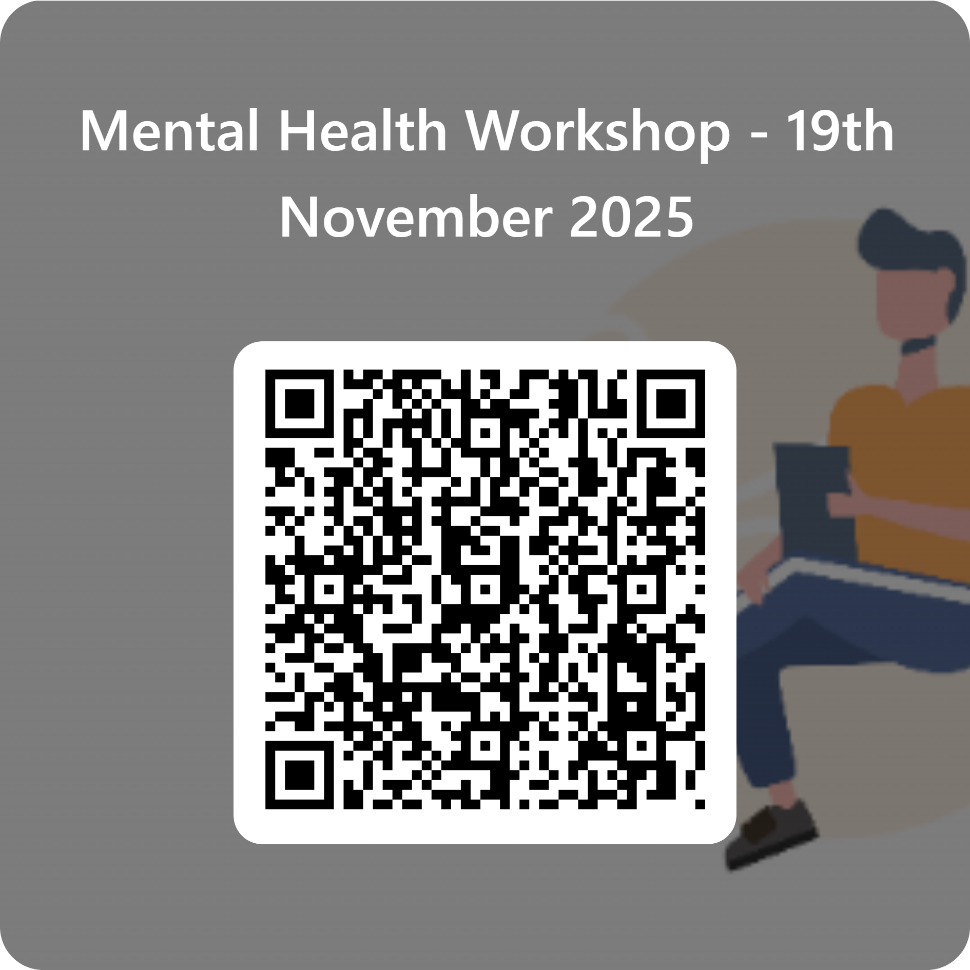

Mental Health Workshop
Improving communication & Red flags
Award
CPD certificate
Duration
1 day course
Location
Campus-based, Bolton
Date
Nov 19th 2025
Course details
This one-day training course provides essential knowledge and skills for responding safely and effectively to mental health patients. It is ideal for aspiring clinicians in the mental health field, as the course focuses on clinical aspects and offers opportunities to develop crucial communication skills and risk assessment techniques required for this role.
Key content includes
Audience
Enhancing communication skills with Mental Health patients
De-escalation of challenging behaviour
Risk assessment with focus on suicide and self-harm
Adverse childhood experience and impact of childhood trauma on mental health
Stimulated learning – Virtual reality & communication skills
This workshop is open to health and social care professionals, including but not limited to nurses, social workers, occupational therapists, mental health and wellbeing practitioners, counsellors, and psychologists
Key features
Assessment
No formal assessment.
Feedback will be given during the stimulated learning for reflective practice.
Taught on a university campus by an experienced healthcare professional and educator, with effective simulated training ( VR & simulated patients)
CPD certificate
To share your interest, scan the QR code

