Slide 1
EARLY identification TOOLKIT
Dr Charlotte Reddick

Slide 2
aims
EARLY
INTRODUCTION
What is the EARLY toolkit?
What are the benefits?
How do I use it?

Slide 3
Stockport LCS Framework
EARLY
INTRODUCTION

Slide 4
What is it?
EARLY
INTRODUCTION
Toolkit to help primary care identify patients who may be in the last year of life

Slide 5
Early identification toolkit
EARLY
INTRODUCTION

Slide 6
What is it?
EARLY
INTRODUCTION
Frailty
Dementia
COPD
Heart failure
MS
MND
Cancer
Identify people entering the last year of life

Slide 7
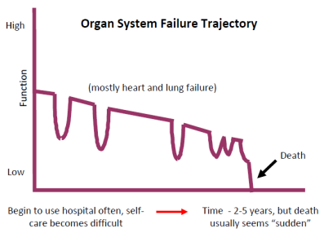
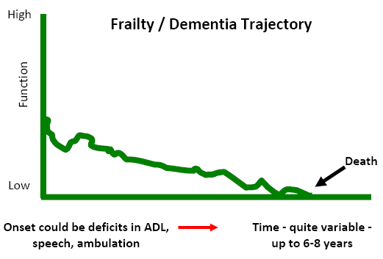
HOW CAN A TOOL HELP YOU?
EARLY
INTRODUCTION
Help with recognising end of life…..

Slide 8
Early identification toolkit
EARLY
INTRODUCTION

Slide 9
How to clinically validate
EARLY
INTRODUCTION
Would you be surprised if they died within the next year?
Unstable, deteriorating, complex symptom burden.
Decreasing response to treatments and decreasing reversibility.
Progressive weight loss (>10% in 6 months).
Repeated unplanned hospital admissions.
Notes:
Indicators of decline

Slide 10
Early identification toolkit
EARLY
INTRODUCTION

Slide 11
WHAT ARE THE BENEFITS TO ME IDENTiftying decline?
EARLY
INTRODUCTION
Increase those identified and included in your palliative care list
Increase the proportion patients offered advance care planning
Increase potential for the people under your care achieving their wishes and preferences at the end of life

Slide 12
Sounds GREAT, BUT I’M ALREADY SNOWED UNDER….
EARLY
INTRODUCTION
Running the EARLY search – Admin team
Validating the generated list – Split between clinicians
Advance care planning
- Moving the conversation upstream
Take small chunks
Resources in toolkit & ACP course

Slide 13
Early identification toolkit
EARLY
INTRODUCTION

Slide 14
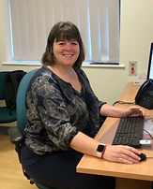
Want more support?
EARLY
INTRODUCTION
Charlotte Reddick – creddick@nhs.net
Karen McEwan – Park View Practice & Clinical lead for planned care and cancer Stockport locality
Karenmcewan@nhs.net
Sarah Griffiths – Finney Lane Surgery, GP Facilitator Stockport Palliative Care Team
Sarah.griffiths10@nhs.net

Slide 15
Thank you
EARLY
INTRODUCTION
https://www.cheshire-epaige.nhs.uk/wp-content/uploads/2023/03/EARLY-Toolkit-V2.0-March-2023.pdf

