Slide 1
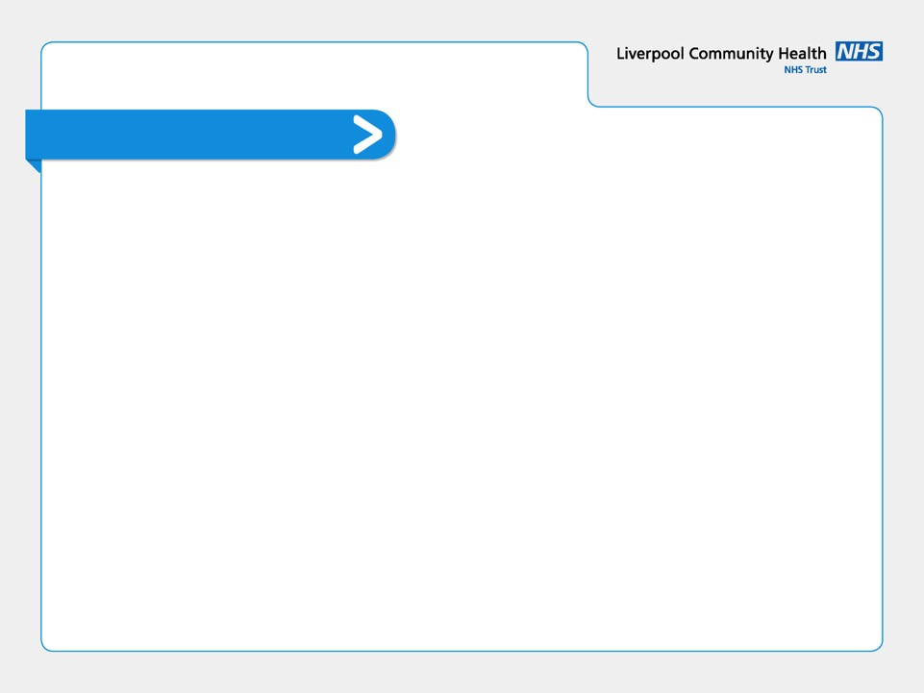
Track 4
IM&T Support teams and the Digital First Primary Care Programme

Slide 2
Session Objectives
Understand the teams available to support GP practices with IT and Digital and what they do and how they can help
Gain an understanding of the new desvelopments to the servicedesk portal
Gain a greater understanding of the data quality service, their workplan and what they can offer
Gain an overview of the digital first primary care programme

Slide 3
IM&T Support
CCG Team
Laura Hosey-Davies Pete Laven
Associate Director IM&T Primary Care IT Manager
GMSS
Data Quality Team – Andrew O’Donnell et al
Service Delivery Manager – David Walsh
Service Desk
Project Management – Lucy Wright, Ali Irfan & Sarah Chambers
Viaduct
Digital Facilitator Team

Slide 4
GM Shared Services IT Update
David Walsh
IT Service Delivery Manager
Service Delivery Management
Portal Improvements
Knowledge Base
Staff/Asset Registers
Feedback
Practice Manager’s IT Forum

Slide 5
Service Delivery Managers
Your primary point of contact for:
Escalations
Compliments
Complaints
Suggestions
David Walsh (david.walsh@nhs.net)
Salford, Stockport and Wigan
Sanjeev Jairath (sanjeev.jairath@nhs.net)
Manchester, Trafford
Chris Ramsdale (chris.ramsdale@nhs.net)
Bury, Heywood Middleton and Rochdale, Oldham

Slide 6
Portal Tours
New developments to the Service Desk Portal, now released!
Performance reports
Log an Incident
Standard and Non-standard catalogue items
Search Call History
Knowledge Base

Slide 7
Knowledge Base
Accessed via Service Now
Helpful guides on getting yourself up and running:
Accessing IT Support
General Troubleshooting
Clinical Systems
NHS Mail
Office 365

Slide 8
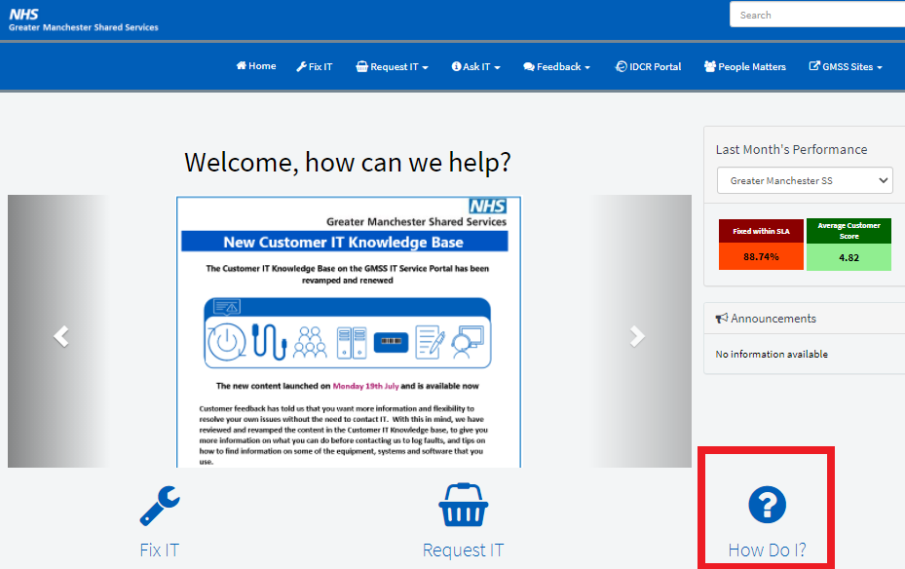

Slide 9
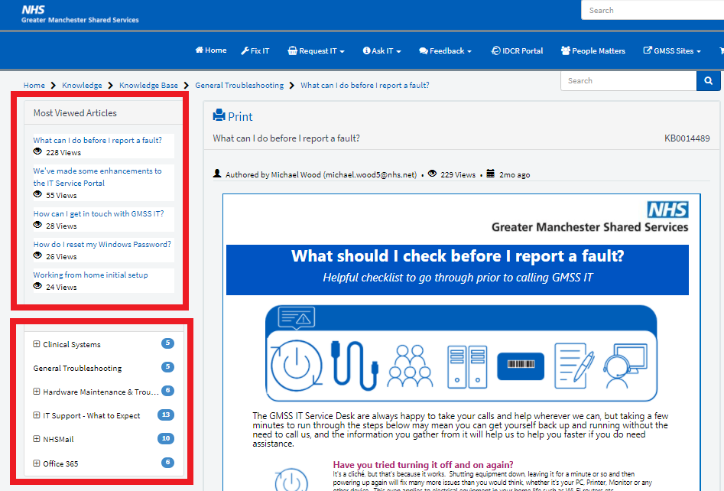

Slide 10
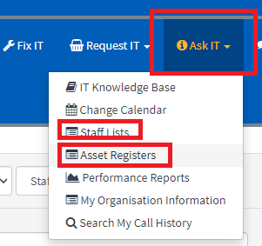
Staff/Asset Registers
Check to see if the Staff and Assets assigned to your Practice are correct and up-to-date:

Slide 11
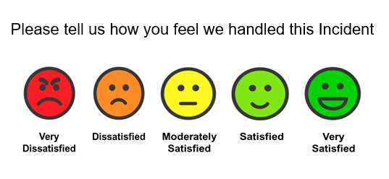
Feedback
Call closes generate a user feedback email – we would welcome users to feedback on the service as much as possible:

Slide 12
Practice Manager’s IT Forum
10:00am – 11:30am
First Wednesday of every month
What are we doing well?
What can we improve?
What challenges are you facing in your Practice?
Any upcoming initiatives

Slide 13
GMSS Data Quality Team
Stockport Masterclass
22 June 2022
Dawn Lowe
Data Quality Service Lead

Slide 14
Background to Data Quality Team
13 members of staff covering 8/10 Localities (Trafford / Wigan have in house DQ Teams).
Majority of the team have worked in DQ Teams across PCTs before becoming a shared service in 2013.
Several years of experience and expertise in all 3 GP clinical systems in use across GM.
Each member of the team primarily completes work for a specific Locality, however we do cross matrix working across GM.
New NHS GM Integrated Care organisation means we are aiming to create more DQ resources at scale.

Slide 15
DQ Service Offering
All Localities with an SLA for the GMSS DQ Service can request unlimited support for each of the following areas:
Standardised Coded Specifications
Disease Register Validation Searches
Data Entry Templates
Referral Forms / Proformas
Search & Reports
SNOMED CT Awareness Sessions
QOF / Primary Care Standards Support
National Project Support
Clinical System Migrations (limited support)
General DQ Advice & Guidance
Trafford / Wigan currently purchase Suspected Cancer Referral Forms and EUR Funding Request Forms created at GM level.

Slide 16
GM Resources Created / In Development / Suggested
Case Finding
Childhood Immunisation Cleansing Exercise
COVID Vaccination Programme
Ethnicity Searches
Funding Request Forms
IIF PCN DES (inc. Structured Medication Review)
Influenza Submissions
LD Assurance Audit
Long COVID ES
National Diabetes Prevention Programme (NDPP)
NHS Health Checks / CVD Prevention
Safeguarding Searches / Template
Serious Mental Illness Searches
Suspected Cancer Referrals
Weight Management ES
Young Onset Dementia
+ Various referral proformas / ad hoc requests
Demonstrations can be provided on request.

Slide 17
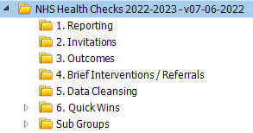
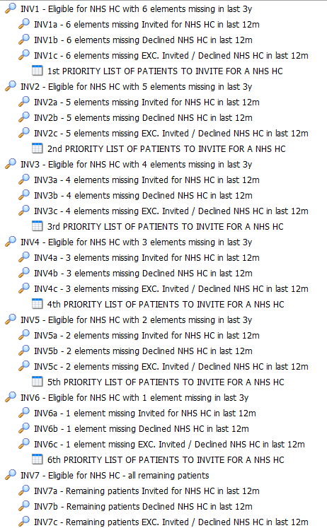
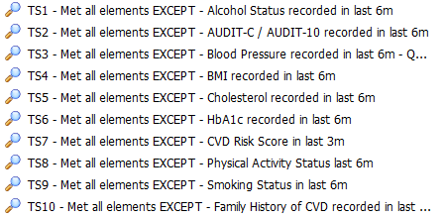
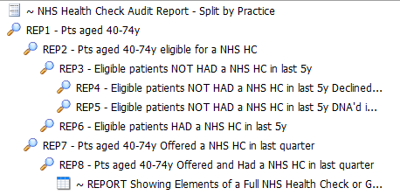
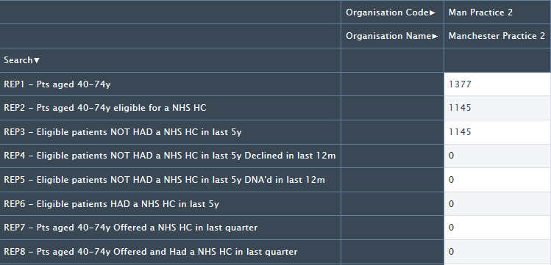
NHS Health Checks (example)
Searches have been developed which are currently being reviewed by GM NHS Health Check Leads.
Allows practices to invite patients in priority order.
Gaps can be identified (to check if a good quality health check has been completed).

Slide 18
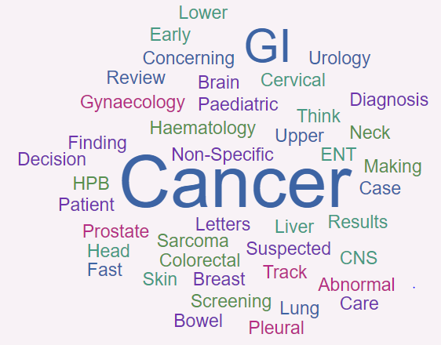
GM Cancer Related Resources Created / In Development / Suggested
Cancer Screening Searches (Breast / Bowel / Cervical)
Decision Making Algorithms / Infographics
Suspected Cancer Referral Forms
Suspected Cancer Referral Patient Letters (x3)
Suspected Cancer Referral Protocols
Cancer Care Reviews (PCN Pilot)
Early Cancer Diagnosis DES – Liver Searches
Early Cancer Diagnosis DES – Prostate Searches
Data Cleansing Searches
Abnormal Results (no follow-up)
Cancer Diagnoses (no Fast Track Referral)
Case Finding Searches (associated codes / medication, not on register)
Fast Track Referral (no Patient Leaflet Given)
Patient Leaflet Given (no Fast Track Referral)
+ Other Ad Hoc Requests

Slide 19
Smartcard Access to GP Systems
To enable the DQ Service to install the resources on clinical systems a DPIA has been signed off by IG Teams.
Practices have been provided with comms to indicate their preference for DQ to dial in to complete installations.
Central Team + 2 others for business continuity.
Confidentiality Agreements (signed).
Audit trail (DQ profile set up by Registration Authority).
Going forward:
EMIS Enterprise (search & reports).
Resource Publisher (templates / referral forms).

Slide 20
Data Quality Drop-In Sessions
Established in Bury, Manchester, Salford (led in various ways).
Attendees (mainly Practice Managers).
Held monthly.
Topics of interest / demonstrations / Q&A’s.
Will be arranged for Stockport from July (invitations to be circulated).

Slide 21
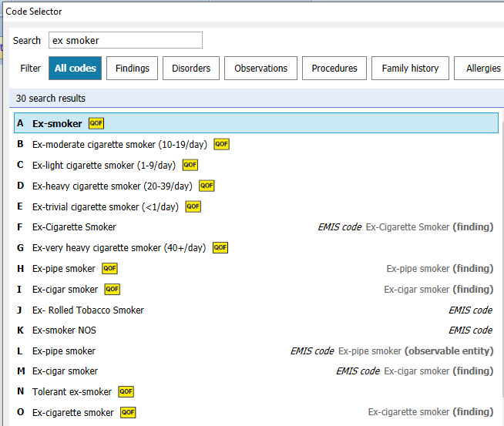
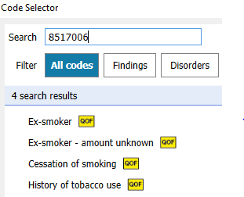
Awareness Sessions
Searches & Reports
Data Entry Templates
Referral Proformas
SNOMED Coding
Calendar of sessions throughout the year.

Slide 22
Questions

Slide 23
Optimising digital first primary care across GM
GM Health and Care Digital Transformation Board
2 February 2022

Slide 24
Digital is a major driver of transformation for general practice to meet increase demand
GM digital first primary care 3 stage programme:
Phase 1: Understand
Diagnostic of key drivers impacting demand, deep insights from primary care
Understanding patient perspective and pain points
Public useability testing of tools
In response to covid-19 pandemic practices rapidly deployed virtual consultation and triage solutions to deliver digital services. This was backed by a co-produced outcomes framework between GPs, practice managers and patients.
Digital technology is a major lever of transformational change, but practices need more support to deliver the maximum benefits, drive efficiency and improve patient outcomes.
Localities, GP providers and digital teams are working together on a joint £3m programme to deliver a blueprint to drive improvement and design digitally inclusive GP services for citizens
Phase 2: Reimagine
Design a GM blueprint and implementation
Build core patient profiles into the design and blueprint to support inclusion
Coproduce with patient cohorts
Phase 3: Implement
Build a delivery plan and implement improvements in each practice
Public facing campaign to build trust in digital
Deploy digital facilitators

Slide 25
GPs and practice staff provided valuable insights into daily pressures and challenges impacting digital optimisation
Practices are facing more aggregate demand
Monthly volume of requests through all channels increased from ~25% of practice list size in January 2020 to ~35% in January 2021. Following a quantum leap in adoption of digital at the start of the COVID-19 pandemic, the channel mix has remained fairly constant, with a gradual shift to offline channels observed in recent months. The types of request have remained constant.
Some practices are reverting back to old processes due to increased demand
GP practices are increasingly switching off digital channels: the average “openness” score for AskMyGP practices in GM fell 25% from June 2020 to September 2021.
A key driver of demand is likely recovery from COVID-19 backlog
Given the mix of how citizens make appointments has not changed dramatically, it does not appear likely that increased demand can be explained solely by reference to easier access through digital channels. Therefore, the likely drivers of demand are (i) spill over effects from backlogs in other settings of care (e.g., patients chasing up their referrals) and (ii) COVID-19 induced primary care demand.
Practices have not adapted their ways of working to meet this increased demand
Few practices have adapted staff working patterns and/or matched capacity with demand data; only half of practices use digital template responses; and 28% of practice have never reviewed demand data extracted from the online consultation tool.
Practices are facing an increase in non-patient-facing workload
Practices identified two primary drivers of this increase: (i) an increase in Secondary Care generated work such as follow-up bloods at GP or chasing results and (ii) managing the large inflow of letters which arrive at the practice – some by mail, some electronic, and some by patient themselves. Lack of standardisation adds substantial burden to admin workloads and GPs can spend up to ~1-2 hours reviewing letters per day.

Slide 26
Patients understand the benefits digital can bring, but there is a lack of trust and confidence in digital GP services
Public insights and experiences
Accessibility audit
Accessibility errors were found across all of those reviewed, meaning none of those sampled were compliant with NHS standards. These problems were often serious and prevented patients from accessing the sites.
Making things better | Patients are willing to change and adopt new behaviour if they see the benefits. Some have seen the positive impact digital tools can have
Impact on patients | Some feel forced to use the digital system, anxious if unable to speak to someone, too many steps to do something simple, frustration about being turned off – leading to more calls.
Digital Fragmentation | Confusion between GP websites, 3rd-party tools and NHS App. Lack of awareness & poor user experience for some tools/websites. Unsure of logins & who to contact for help
Barriers to access | Patients struggled due to complicated instructions. Lack of easy way for carers to access services. Those without English as a first language struggled with poor online translations.
Communications and awareness | Poor awareness of online services and how to use them. Confusion caused by technical or complex language. Suspicious about directed to 3rd party sites with adverts & text messages.
Content issues:
Missing titles
Language of webpage not identified
Links to inaccessible problems resizing texts
Images of text
Insufficient colour contrast
Language and jargon
Cluttered content
Navigation issues:
Inconsistent navigation
No option to skip repeated content
No headings/ unclear heading descriptions
Auto-playing content
Video without captions/transcriptions
Forms issues:
Missing form labels
Not enough support or information to help users correct form entries
Processes not keyboard friendly

Slide 27
Digital first primary care blueprint
Key recommendations:
Improving practice operations and ways of working, particularly with more effective triaging at point of initial patient engagement
Enhancing digital skills and capabilities of practice staff and patients to effectively use digital tools
Reducing the burden of non-patient-facing workload
Supporting patient education about when to present at the GP practice and appropriate care pathways
Ensuring digital inclusion and improved patient access by providing IT support and alternative channels of engagement
Practice ways of working
Capability building
Non-patient-facing workload
Patient comms & expectations
Digital inclusion and patient access
1
Develop consistent front-end template
"Soft relaunch” digital for specific cohorts
Establish centralised Hub across PCNs for high-volume, low-complexity tasks
Improve GMCR functionality
Build interoperable systems to route demand to other settings of care
6
Develop and maintain standardised training programmes and library of resources
Establish a sustainable network of Digital Champions to deliver digital change
Build best practice forum
9
Establish GM-wide standards for non-patient-facing workload
Embed new, clear electronic letter templates
Explore role for OCR and RPA solutions
12
Embed standardised templates for practice websites
Improve OC platform user interface
Roll out GM-wide patient communications campaign
Coordinate patient training materials distributed via network of Patient Champions
16
Establish central call centre
Establish patient IT support / service desk
2
17
13
3
10
7
14
11
15
4
8
5
Notes:
JANET
As a result of the insight and as part of the reimagine phase, we have worked with CCGs and practices to identify 17 capabilities or initiatives that would support us to address the issues identified
Some of these are fairly straightforward to implement such as developing standard training and resources for practices, others are much more complex and would require investment and resource
Key recommendations include developing digital skills and capabilities within practices, reduce burden of non-patient facing workload on clinical staff, build public trust and education and design services that are inclusive for all

Slide 28
Digital first primary care implementation plan
Deployment of Digital First Facilitators Enable and support business change in each PCN
5 localities recruiting locally
5 localities recruiting centrally
Digital First Primary Care Practice Manual
Patient engagement insights and guidance on how to use each tool to optimise capacity management and the support on offer at the GM, locality and PCN levels, will be produced for practices to benefit from a physical copy.
Digital First Academy Surfacing resources and training through 6 modules for individuals & teams to adopt locally
Supported by GM GP Excellence and for use by:
Digital First Facilitators
Digital Champions - locally identified practice / PCN staff (clinical & non-clinical) & patients
Improving access including implementation of design principles for GP websites & influence of GP EPR platforms & online consultation platforms
Centralised PCN Hub Proof of value – to optimise management of administrative and high-volume / low complexity tasks
Influencing on-line consultation platform User interfaces & workflows
Improve accessibility
Public comms campaign Support access, focusing on building trust and enabling traditionally disadvantaged groups & encouraging best use of all (digital and non-digital) channels
Lighthouse projects

Slide 29
Any Questions…
?

