Slide 1
Triage First
Tracy Platt - Operations Manager, Hulme Hall Medical Group

Slide 2
Triage First
Consult with your Doctor Online
Find help, advice and consult online with Patient Triage
Website https://www.hulmehallmedicalgroup.nhs.uk/
Practice using since April/May 2020
Patients use on-line form or can telephone practice
Option 1 if you have internet access (hang up)
Option 2 hold for a Receptionist
Receptionist will complete form on behalf of patient

Slide 3
Triage First
Online form 3 main options
Consult with your GP
Medication Requests
Any Other Enquiries

Slide 4
Triage First
Advised if red flags call 999
No red flags continue with form
Option to send photos via link
Confirmation text if mobile number provided
GP appointments prioritised over other requests

Slide 5
Triage First
Medication requests within 48 hours
Urgent - appointments on the day or within 2 days
Patient sent telephone appointment
Non urgent – appointment made with community pharmacist, optometry team etc.
Message to patient on submitting the form states “Your query will be read and acknowledged by a text or phone call within 2 working days….”

Slide 6
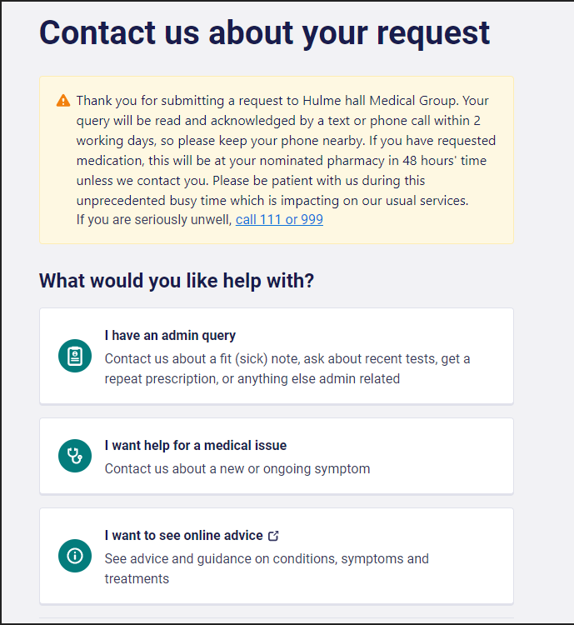
Patient Message

Slide 7
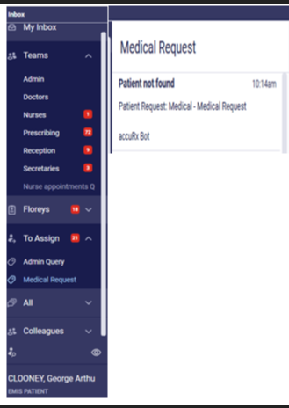
At Reception – Step 1
1. Inbox folders are opened and a
Receptionist filters through the Assign
folder, prioritising Medical requests

Slide 8
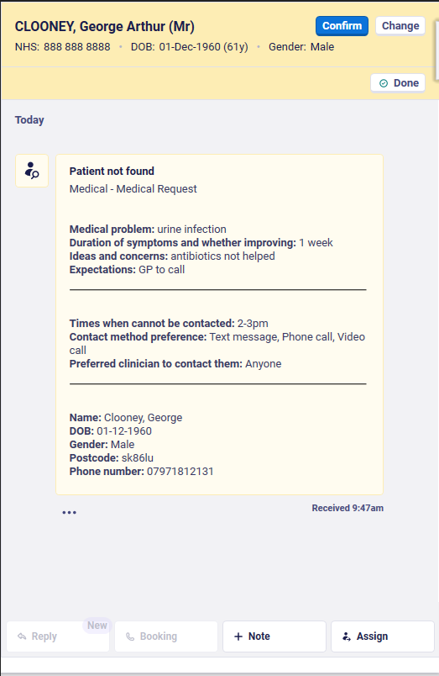
At Reception – Step 2
2. The Medical request is opened,
matched and confirmed to the
correct patient in EMIS

Slide 9
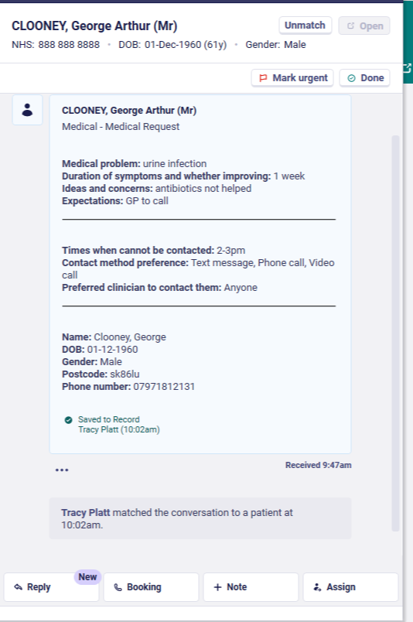
At Reception – Step 3
3. Once the patient query is read, the
Receptionist will save to patient record
and signpost to relevant list

Slide 10
At Reception – Step 4
4. Once the patient is added to the telephone triage list, the GP will open patient consultation and contact the patient on reading the eConsultation

Slide 11
AccuRx Reports

Slide 12
AccuRx Reports

Slide 13
AccuRx Reports

Slide 14
Summary
Patient feedback mostly positive
Some problems at first and fixes put in place
Some smart phones not compatible

Slide 15
Questions?

