Slide 1
Deaf Awareness and Basic British Sign Language
Teacher: Dipti Patel

Slide 2
Deaf Awareness and basic BSL
Manchester Deaf Centre
Today’s session (45 minutes):
20 mins
Presentation topic
Barriers at medical appointments
Improving accessibility
15 mins
Basic signs for medical settings
10 mins
Questions

Slide 3
Deaf Awareness and basic BSL
Manchester Deaf Centre
Terminology used to describe deafness in a medical sense
Mild deafness (25–40 dB)
Moderate deafness (41–70 dB)
Severe deafness (71–95 dB)
Profound deafness (96+ dB)
People with severe or profound deafness are more likely to use BSL

Slide 4
Deaf Awareness and basic BSL
Manchester Deaf Centre
Lived Experience
What are the most common barriers for deaf people in medical settings?
Receptionist staff ask questions looking at the computer – no eye contact
Waiting room staff announce patients name – wearing a mask
Appointments are limited to 10 minutes – for a deaf person with an interpreter this needs to be flexible as BSL/English translation takes longer.
Appointment letters – ask the person to phone to confirm. Letters from NHS are not written in plain English. Deaf person has to ask an interpreter or member of the family to translate the letter.
Interpreters are not always booked for appointments . Deaf person arrives on time but no interpreter. Waste of time and money.
10-15 mins
Presentation topic
UK Deaf Community
British Sign Language
10-15 mins
Questions and Answers
To finish
Fingerspelling alphabet to take away

Slide 5
Deaf Awareness and basic BSL
Manchester Deaf Centre
Improving accessibility
What are some simple and effective ways of improving accessibility?
Training (through CPD) Deaf Awareness sessions for Receptionist staff – to enable smooth communication with a deaf person.
Medical records should flag up a person is Deaf and therefore staff know how to communicate. Eg; Face the person when you are speaking to them.
Longer appointments for Deaf people.
Email contact address to confirm appointments
Make sure an interpreter is booked if a Deaf person requires one.
10-15 mins
Presentation topic
UK Deaf Community
British Sign Language
10-15 mins
Questions and Answers
To finish
Fingerspelling alphabet to take away

Slide 6
Deaf Awareness and basic BSL
Manchester Deaf Centre
Booking a Sign Language Interpreter
10-15 mins
Presentation topic
UK Deaf Community
British Sign Language
You can book a BSL interpreter by emailing SIU Bookings siu.bookings@stockport.gov.uk
You should state: name, date, time, appointment duration, gender preference (if applicable) or the name of the preferred interpreter
Try to give at least 1 weeks’ notice
10-15 mins
Questions and Answers
To finish

Slide 7
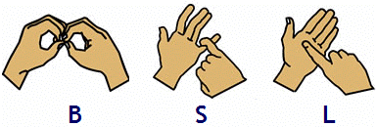
Deaf Awareness and basic BSL
Manchester Deaf Centre
A beautiful and unique visual language

Slide 8
Deaf Awareness and basic BSL
Manchester Deaf Centre
British Sign Language
BSL is a different language to English
Different structure, grammar, and vocabulary, and its own unique ways of expressing meaning
Deaf people who use BSL often struggle with reading and writing English because it is not their first language.
Many parts of mainstream society are difficult for BSL users to access due to this language barrier

Slide 9
Deaf Awareness and basic BSL
Manchester Deaf Centre
BSL order: examples
What is your name? Name what?
My name is Dipti Name me Dipti
Where do you work? Work where?
I work at home Work home

Slide 10
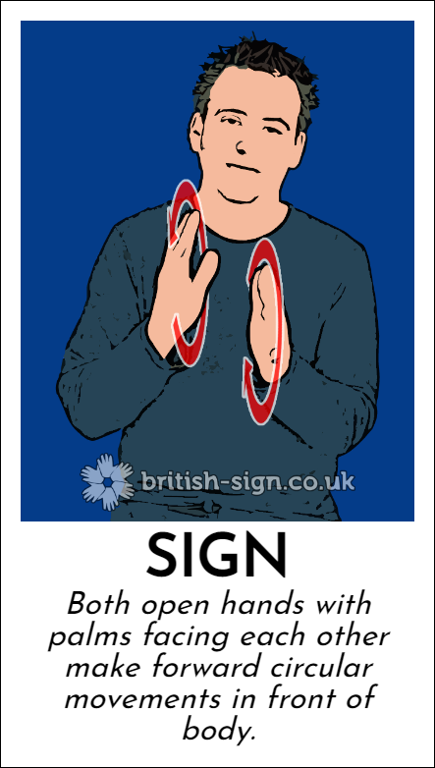
Deaf Awareness and basic BSL
Manchester Deaf Centre
Let’s sign

Slide 11
Deaf Awareness and basic BSL
Manchester Deaf Centre
Useful signs in medical settings
Reception
Doctors
Nurse
Interpreter
Hospital
Appointment
Medication
Blood Test
Operation
Consultation
Waiting Room
Results
Records

Slide 12
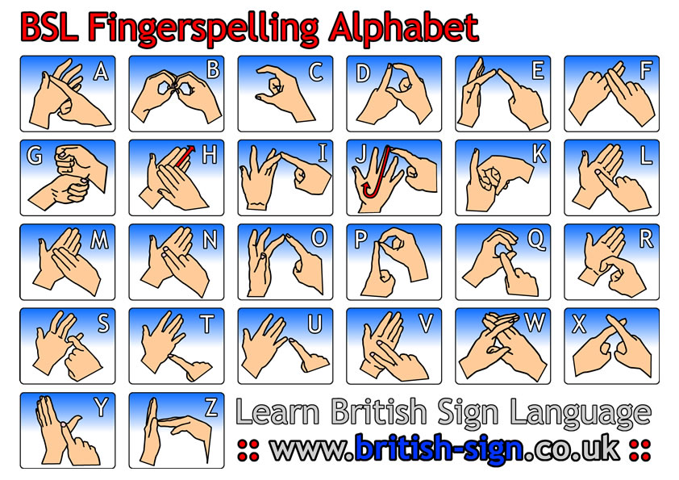
Deaf Awareness and basic BSL
Manchester Deaf Centre

Slide 13
Deaf Awareness and basic BSL
Manchester Deaf Centre
Download and print the fingerspelling alphabet
10-15 mins
https://www.manchesterdeafcentre.com/downloads/bsl-fingerspelling-right-handed.pdf
https://www.manchesterdeafcentre.com/downloads/bsl-fingerspelling-left-handed.pdf
To finish
Fingerspelling alphabet to take away

Slide 14
Deaf Awareness and basic BSL
Manchester Deaf Centre
10-15 mins
Any questions?
10-15 mins
Questions and Answers
To finish
Fingerspelling alphabet to take away

Slide 15
Stockport Interpreting Unit
Telephone spoken language interpreters
Face to face spoken language and BSL interpreters
Video spoken language and BSL interpreters
Translation and proof reading services
siu.bookings@stockport.gov.uk
0161 477 9000

Slide 16
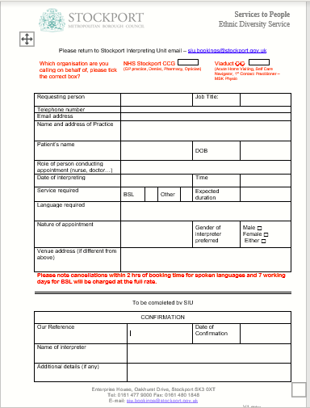
Stockport Interpreting Unit
siu.bookings@stockport.gov.uk
0161 477 9000

