Slide 1
Stockport Integrated Care System What does it mean for Stockport General Practice?
Anita Rolfe Executive Nurse and Interim CEO, Stockport CCG
Viren Mehta GP, PCN Clinical Director and Vice Chair, Viaduct Care

Slide 2
Stockport Integrated Care System
What is an ICB and an ICS?
What does the new structure look like from 1st July?
What will happen to staff who currently work at Stockport CCG?
What does clinical leadership look like in the new system?
What will change from a General Practice perspective?
Why do we need a Stockport GP/Primary Care Board?
How do we ensure Stockport General Practice has a voice in the wider system?

Slide 3
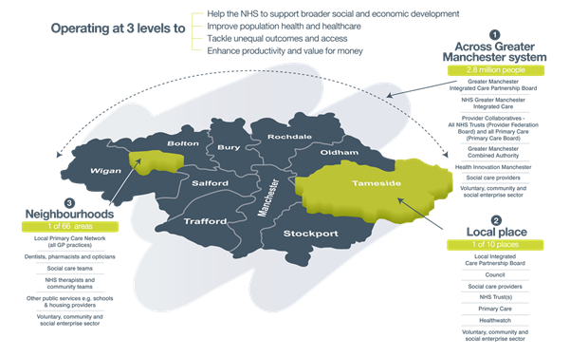
Greater Manchester ICS

Slide 4
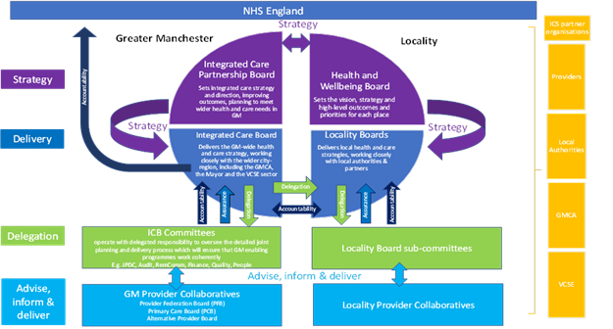
Greater Manchester ICS

Slide 5
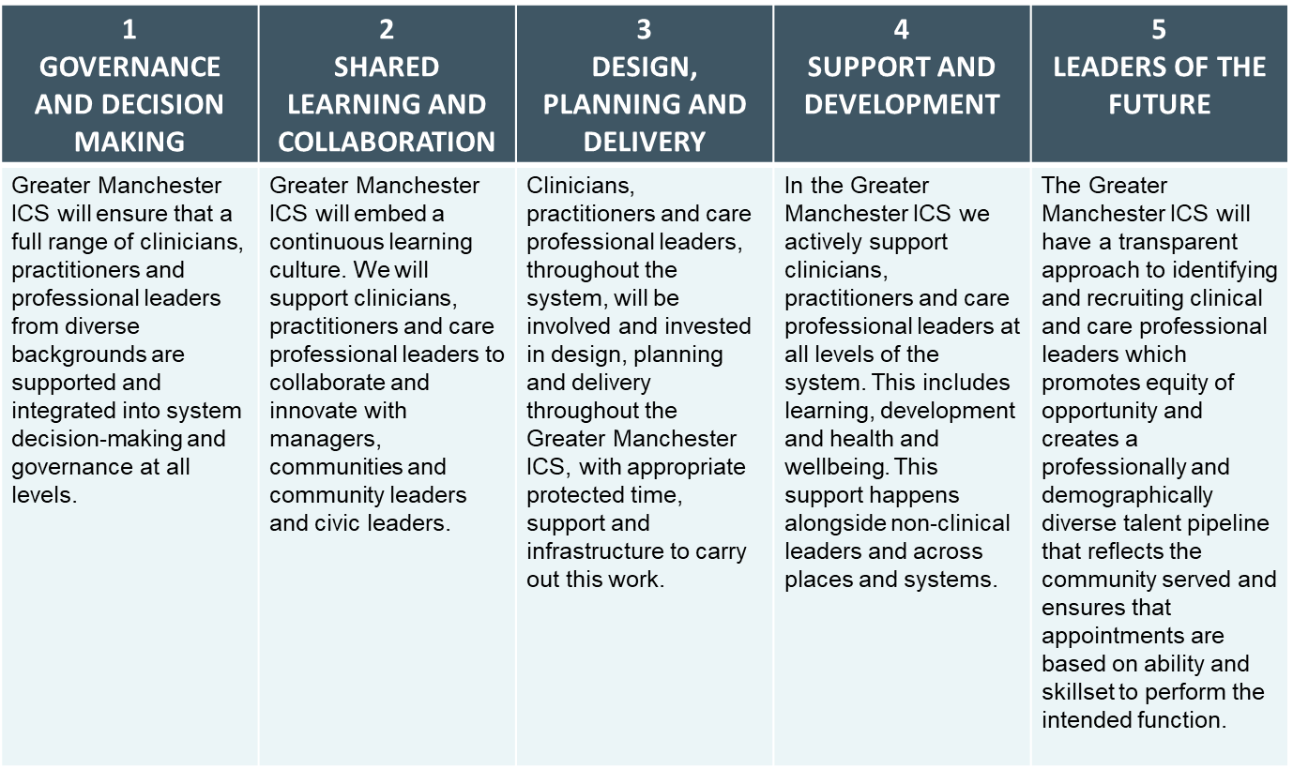
THE 5 PRINCIPLES OF CLINICAL AND CARE PROFESSIONAL LEADERSHIP ACROSS GM

Slide 6
Stockport Primary Care Board Discussion Proposal
Why do we need a Stockport GP/Primary Care Board?
What will it do?
What will its agenda be about?
Who are the members going to be?
When should it start?
How frequently should it meet?
Will there be admin to support it?
How will it feedback to all practices?

Slide 7
Stockport wide participation by Clinical and Care Profession leaders (CCPL)
Responsible for own actions
Accountable to each other
Participative Involvement
Multi – professional Clinical and Care Leadership
Stockport
Leading and supporting the implementation of the strategic intentions of place
Social care - Primary Care - Community Care - Secondary Care – Mental Health
Reducing inequalities and improving well being
A shared purpose of quality improvement across Stockport
Safeguarding
Care Improvement outcomes and improved experience of care

Slide 8
CCPL participation in Governance and Decision Making
Stockport Primary Care Board Governance
Locality Board
Formal committee of the Locality
Provider Partnership Board
Bringing Stockport’s Providers together
Stockport’s GP/Primary Care Board
Bringing Stockport’s Primary Care Together
PCN Meetings and Practice Meetings
Understanding the views of General Practice

Slide 9
Stockport Primary Care Board Discussion Proposal
Why do we need a Stockport GP/Primary Care Board?
To provide a forum for strategic discussion and decision making
To enable a corporate approach and contribution to Provider Partnership and Locality Board
To enable opinion to be sought
To identify the areas where Primary Care would wish to influence at the Provider Partnership
To bring together the different elements of Primary Care

Slide 10
Stockport Primary Care Board Discussion Proposal
What will it do?
Enable the local CCPL contribution to the Stockport Locality
Focus on Primary Care Transformation
Focus on the priorities of the Stockport One Health and Care Plan
Create a structured approach to Primary Care underpinned by an agreed Primary Care Strategy* (*PCB to agree, compilation supported by business partners in consultation with PCNs)

Slide 11
Stockport Primary Care Board Discussion Proposal
What will the agenda be ?
Set in the week just before Provider Partnership, it will consider the Agenda Pack and agree the views of primary care
It will also consider papers presented by Primary Care that align to the strategic work plan (*PCB to agree, compilation supported by business partners in consultation with PCNs)
Items presented by PCNs and practices
GM Primary Care Board discussion topics

Slide 12
Stockport Primary Care Board Discussion Proposal
Who would the members be?
PCN CDs
GM IC Clinical Leads ( formerly CCG Clinical Leads)
Nursing Rep
Practice Manager Rep
LMC
Viaduct
Mastercall
Optometry
Dental
Pharmacy
AHP

Slide 13
Stockport Primary Care Board Discussion Proposal
When should it start?
July
How frequently should it meet?
Monthly
Will there be admin to support it?
The Locality Primary Care Team will support the governance structures and papers
How will it feedback to all practices?
Sharing of the minutes / Summary report
Comms via LMC, Viaduct and PCN CDs/PMs

Slide 14
Annual activity for Stockport Registered Patients

Slide 15
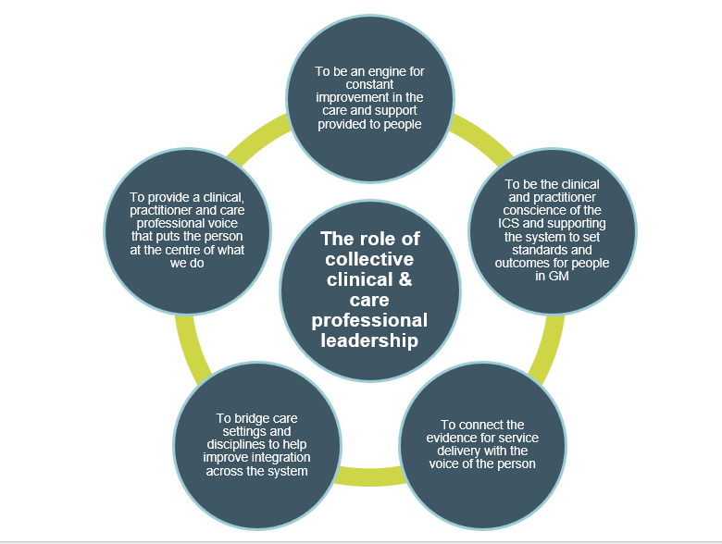
THE ROLE OF CLINICAL AND CARE PROFESSIONAL LEADERSHIP
The role of a CCP Leader across GM at all spatial levels has been explored by the GM CCPL steering group. This has led to role descriptions that have been embedded within a GM CCPL Operating Model

Slide 16
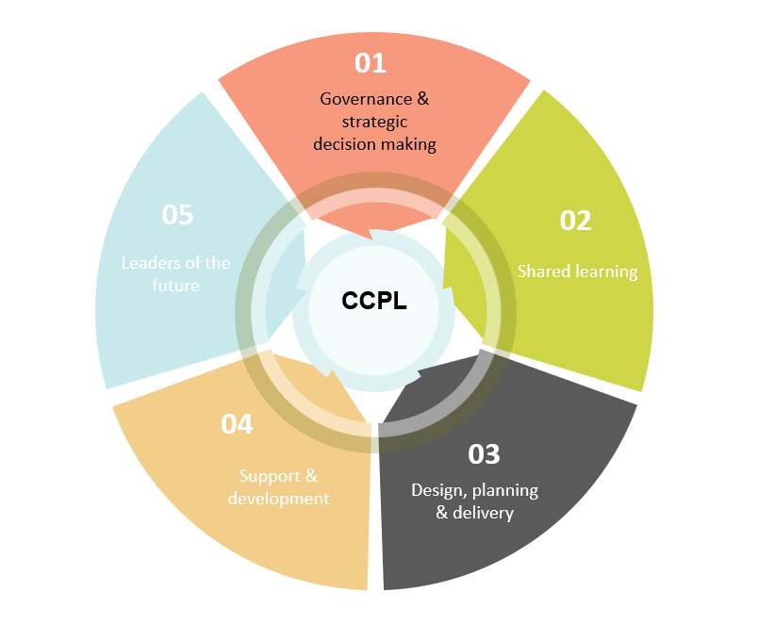
GM CLINICAL CARE PROFESSIONAL LEADERSHIP FRAMEWORK agreed that :
The GM CCPL approach will address the 5 national priorities
Stockport’s Clinical and Care Professional Leadership Model needs to reflect these too

Slide 17
CLINICAL AND CARE PROFESSIONAL LEADERSHIP ACROSS THE GM SYSTEM
Distributed CCPL will be at all spatial levels of GM, building on existing roles and functions. Existing networks will be part of the CCPL across GM, working in a networked approach
Primary Care Board
Neighbourhood
Primary Care Network Clinical Director
Primary Care Networks
People and community assets, including VCSE, schools
Multiagency care professionals
PBP Care Professional Lead
PBP Care Professional Advisory Group
Nominated programme / topic professional leads
Primary care & GP leaders / groups
Lived experience groups
Place
Place based VCSE groups / networks
1x Medical Director, ICB 1X Director of Nursing, ICB
Provider Collaborative Clinical Leadership
Primary Care Network Clinical Leadership
Strategic Clinical Networks
Operational Delivery Networks
GM Programmes (MH, UEC, Maternity, CYP)
GM Clinicall Executive
GM system leads
System
Local Professional Networks
Health Innovation Manchester

Slide 18
Clinical and Care Professional Leaders will fulfil different roles across the different spatial levels and programmes across the whole of GM ICS
Role | Description
Sectoral specific advice and engagement | To offer advice on matters of impact on a particular sector so that an informed view is used for development, delivery and decision making
Specialist professional advice | To offer advice and perspective on matters of impact on a particular topic so that an informed view is used for development, delivery and decision making. This includes setting clinical strategy
Cross sectoral advice and input | Multi-professional and cross sectoral groups capable of generating innovative and holistic thinking through their collaborative knowledge and experience
Leadership for transformation | To ensure that transformation and service redesign is led by clinicals and care professionals who understand the areas of work and the changes needed
Leadership for system development | Clinical and care professional leaders who are influencing the priorities for systems and partnership development at neighbourhood, place and system
Leadership for decision making | Clinical and care professional leaders who ensure that wider clinical and care professionals have been involved in decision making at neighbourhood, place ad system

Slide 19
GOVERNANCE
AND
DECISION MAKING

Slide 20
Spatial Levels of Clinical and Care Professional Leadership

Slide 21
Thanks for listening! Any Questions?

